Slide 1
PMWDS · PROJECT MONITORING & WORKLOAD DISTRIBUTION SYSTEM
Role Based Flow
How PMWDS adapts its navigation, visible data and available actions to the user's role — walked through screen by screen.
Note: roles in PMWDS are dynamic and configurable. The four below are used here to simulate and demonstrate the flow.
Admin
Manager
DepartmentHead
TeamMember

Slide 2
ACCESS MATRIX
What each role can reach
MODULE
Admin
Manager
DepartmentHead
TeamMember
Dashboard
Available
Available
Available
Available
Projects
Available
Available
Available
Available
Project overview
Available
Available
Available
Available
Milestones
Available
Available
Available
Available
Tasks & subtasks
Available
Available
Available
Available
Documents
Available
Available
Available
Available
User administration
Available
Available
Available
Restricted
Departments
Available
Available
Available
Restricted
Profiles & skills
Available
Available
Available
Restricted
Roles & permissions
Available
Restricted
Restricted
Restricted
Activity logs
Available
Restricted
Available
Restricted
Reports
Available
Restricted
Restricted
Restricted
AI insights
Available
Restricted
Restricted
Restricted
Notifications
Available
Available
Available
Available
Scoping is enforced server-side. 'Restricted' means the API returns no data and the route guard refuses to render.
Roles are configuration, not code. These four simulate the flow; any number of custom roles can be defined and granted.

Slide 3
ROLE 1 OF 4
Admin
Runs the whole organization — delivery, people and governance.
Relevant screens in this flow

Slide 4
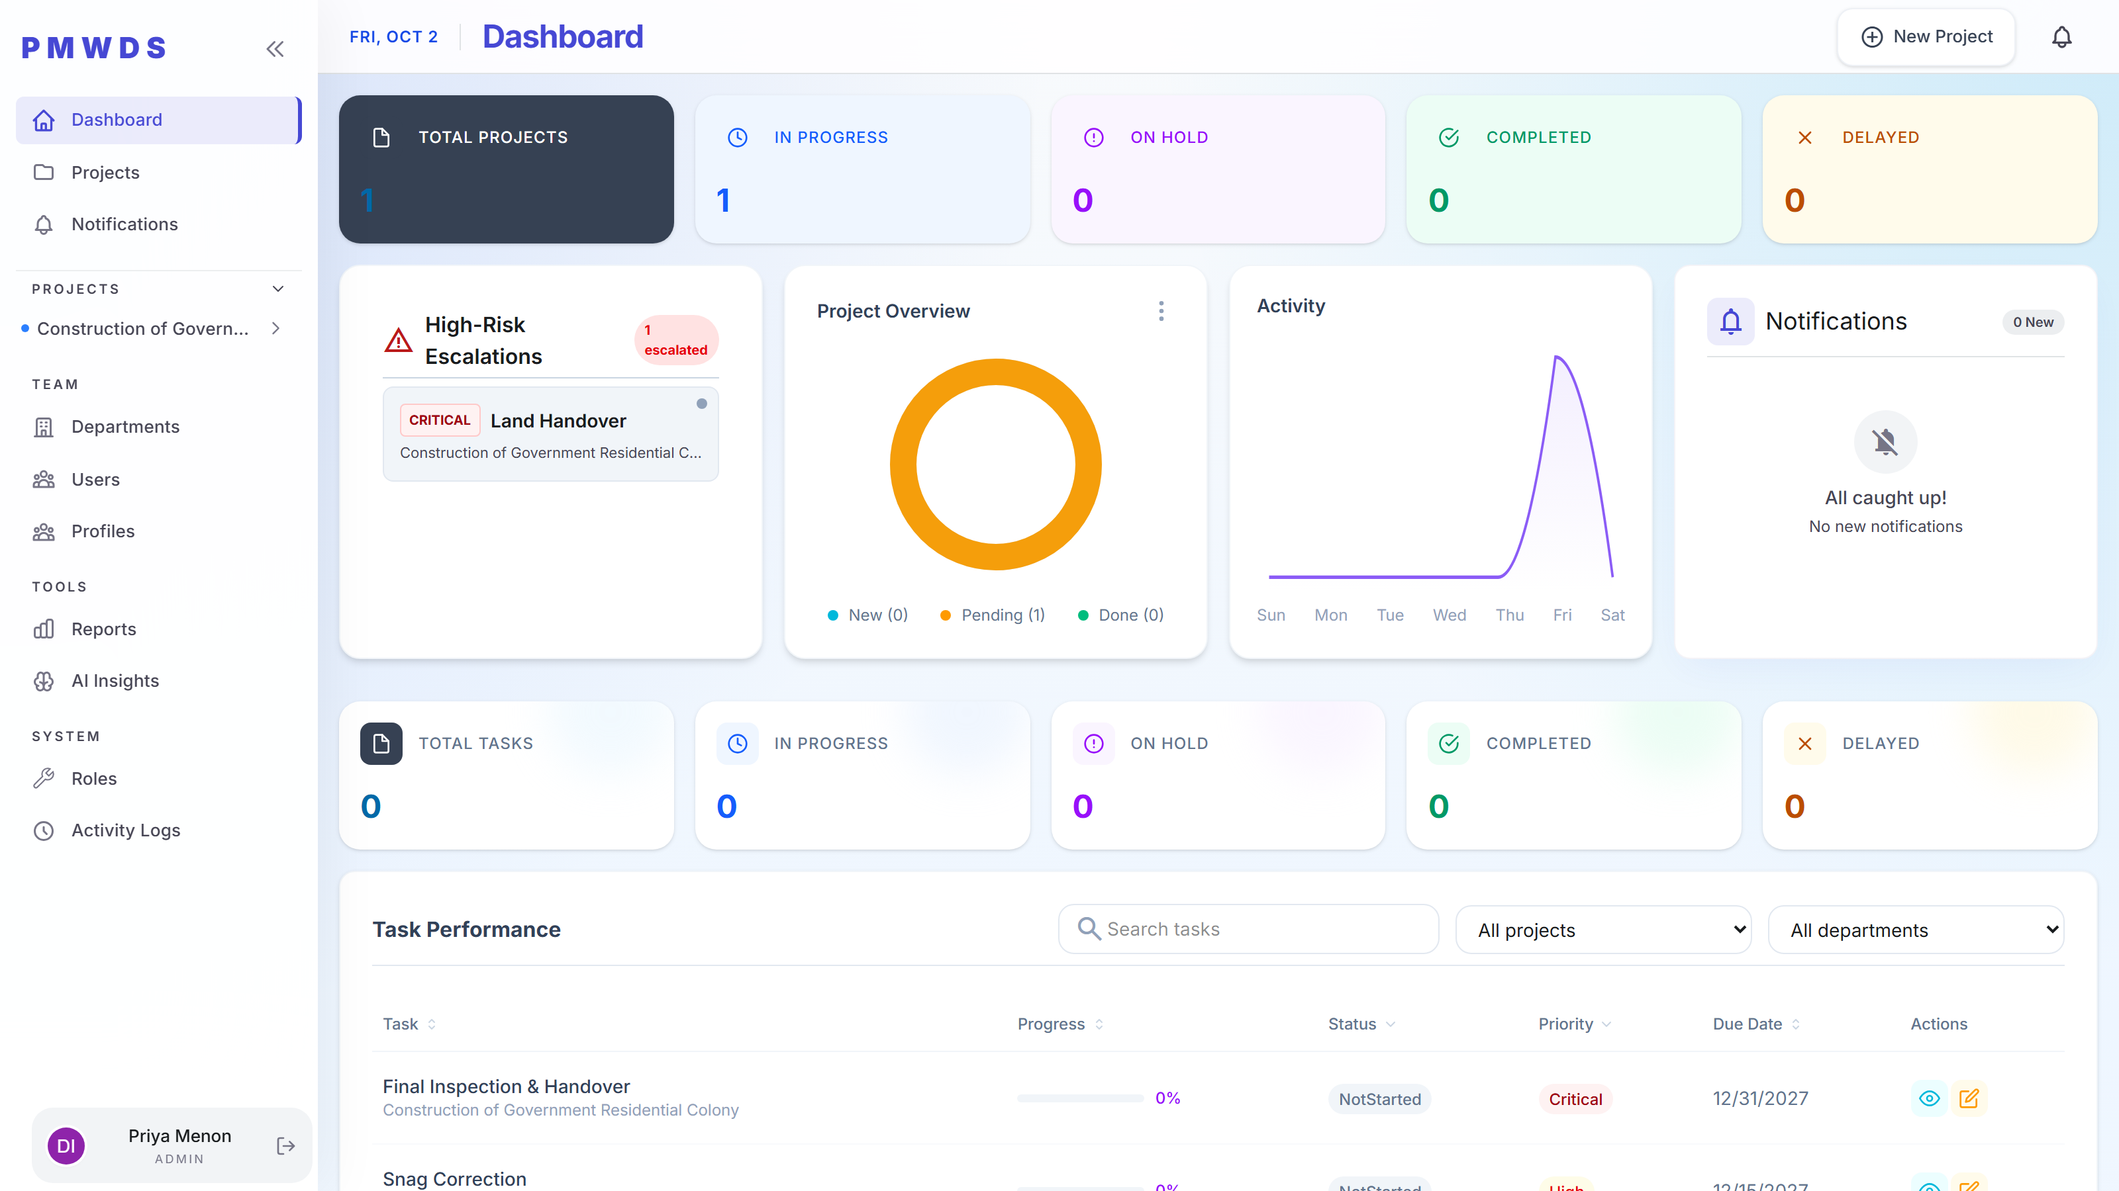
Admin
STEP 1
Every module opens from here. The Admin sees the same dashboard as everyone else — the difference is that nothing in it is switched off.

Slide 5
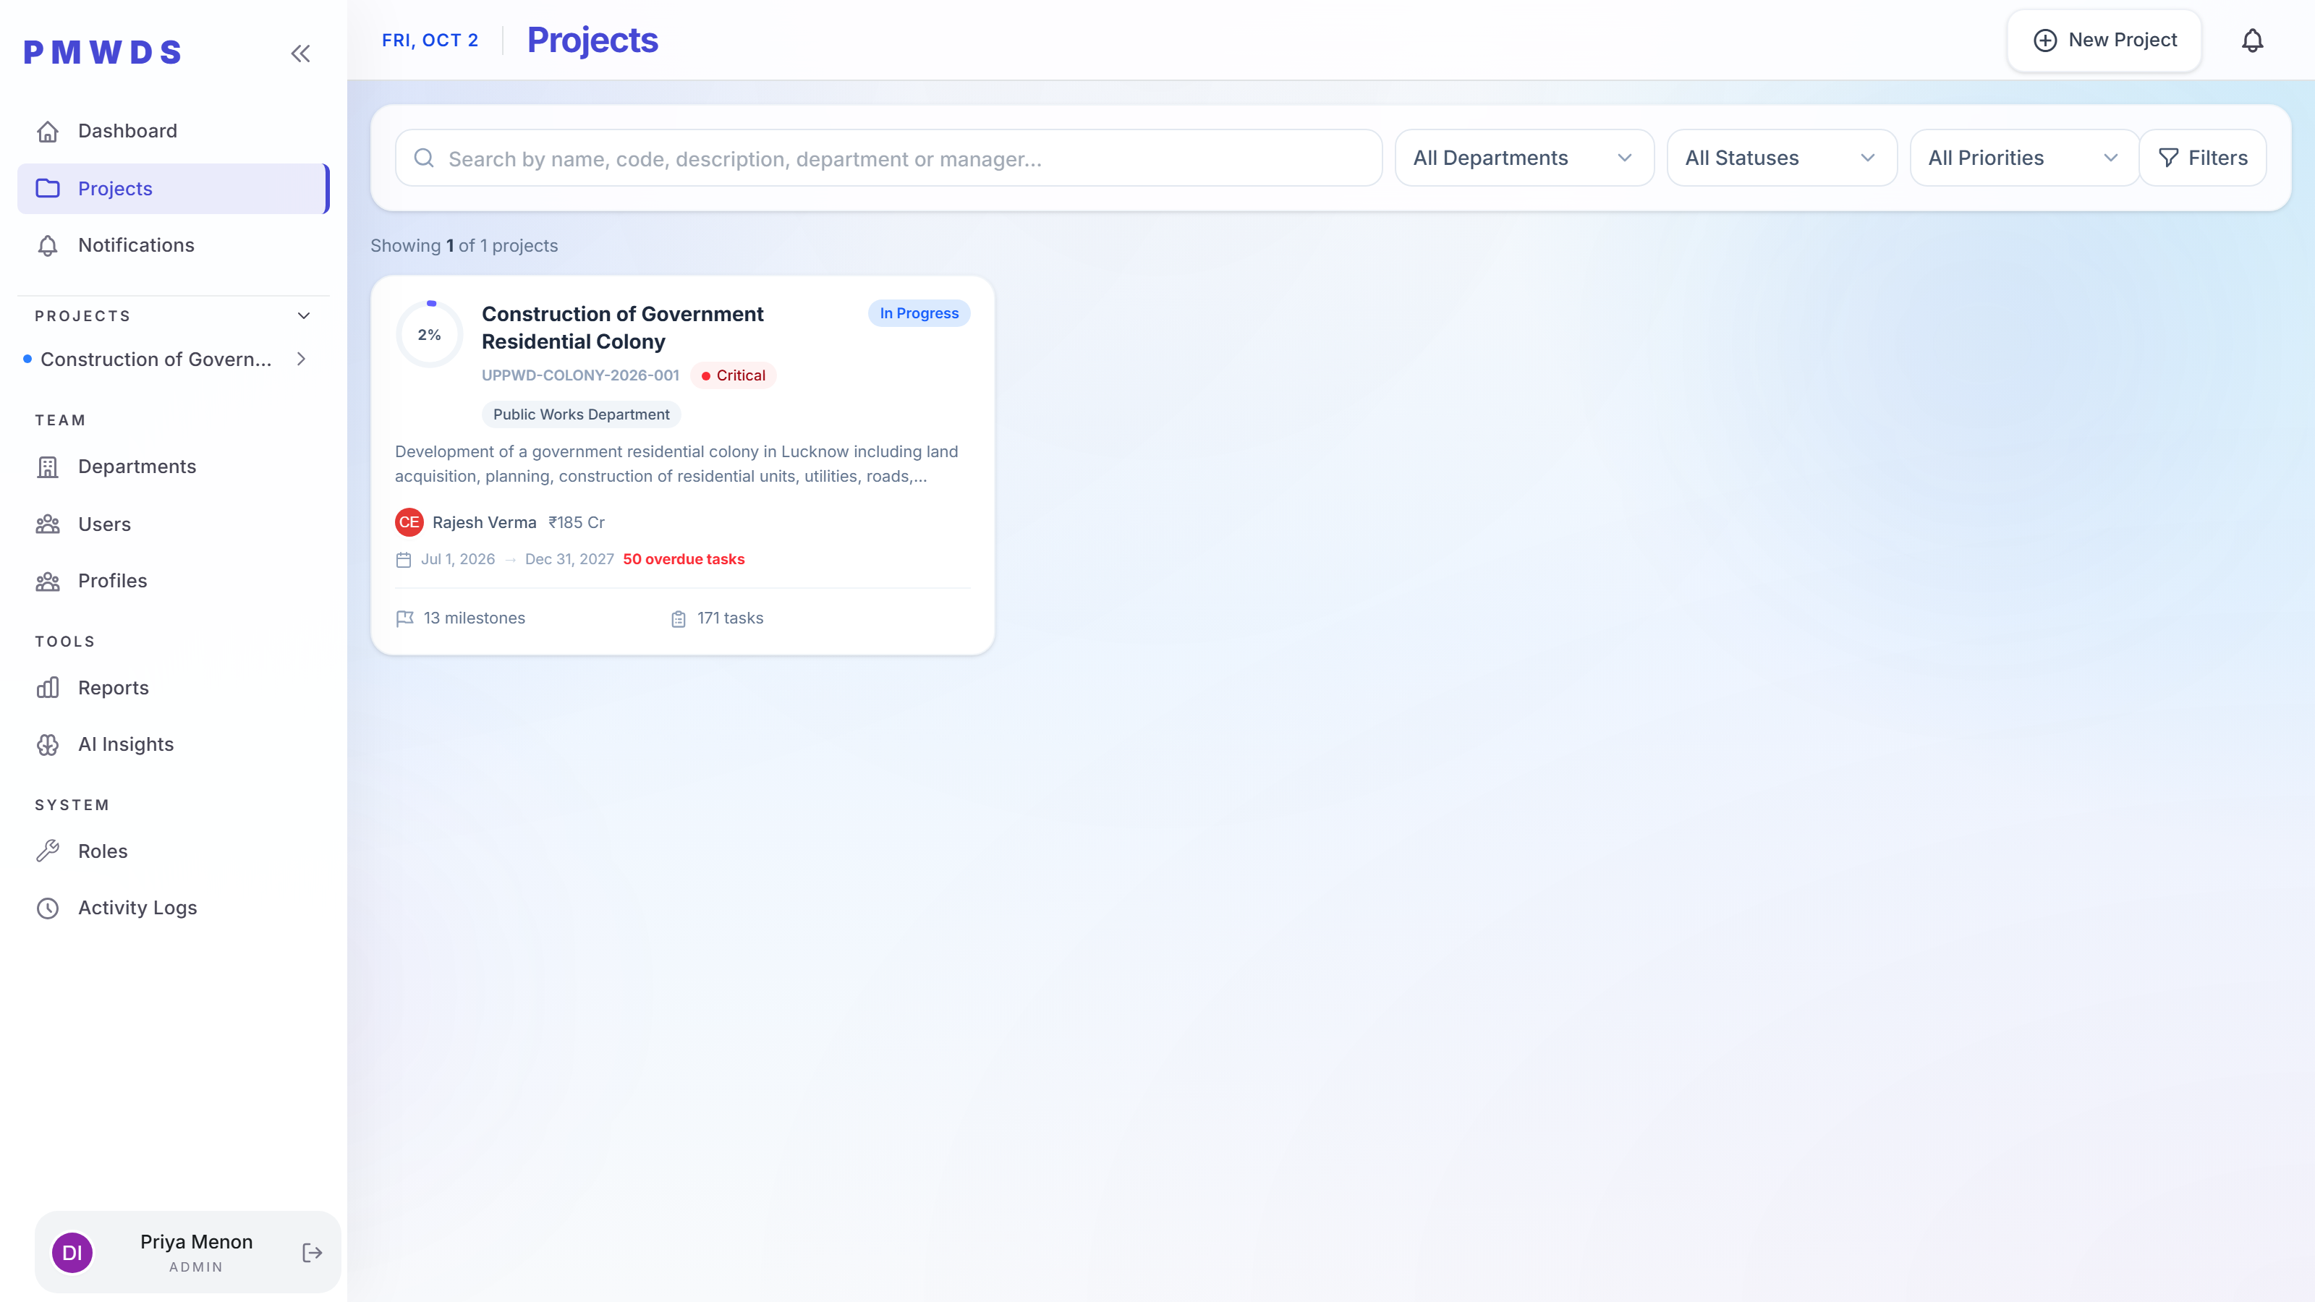
Admin
STEP 2
The project portfolio, filtered by department, status and priority. Search spans name, code, description, department and manager.

Slide 6
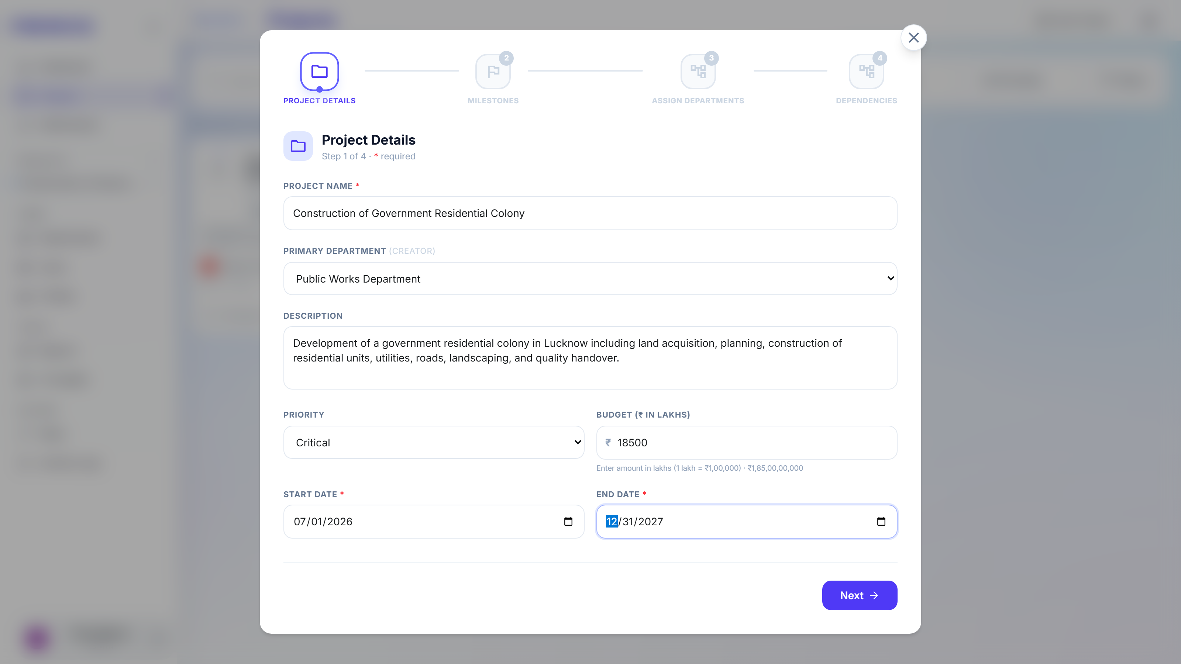
Admin
STEP 3
New Project opens a four-step wizard. Step one captures the name, owning department, description, priority, budget in lakhs and the delivery window.

Slide 7
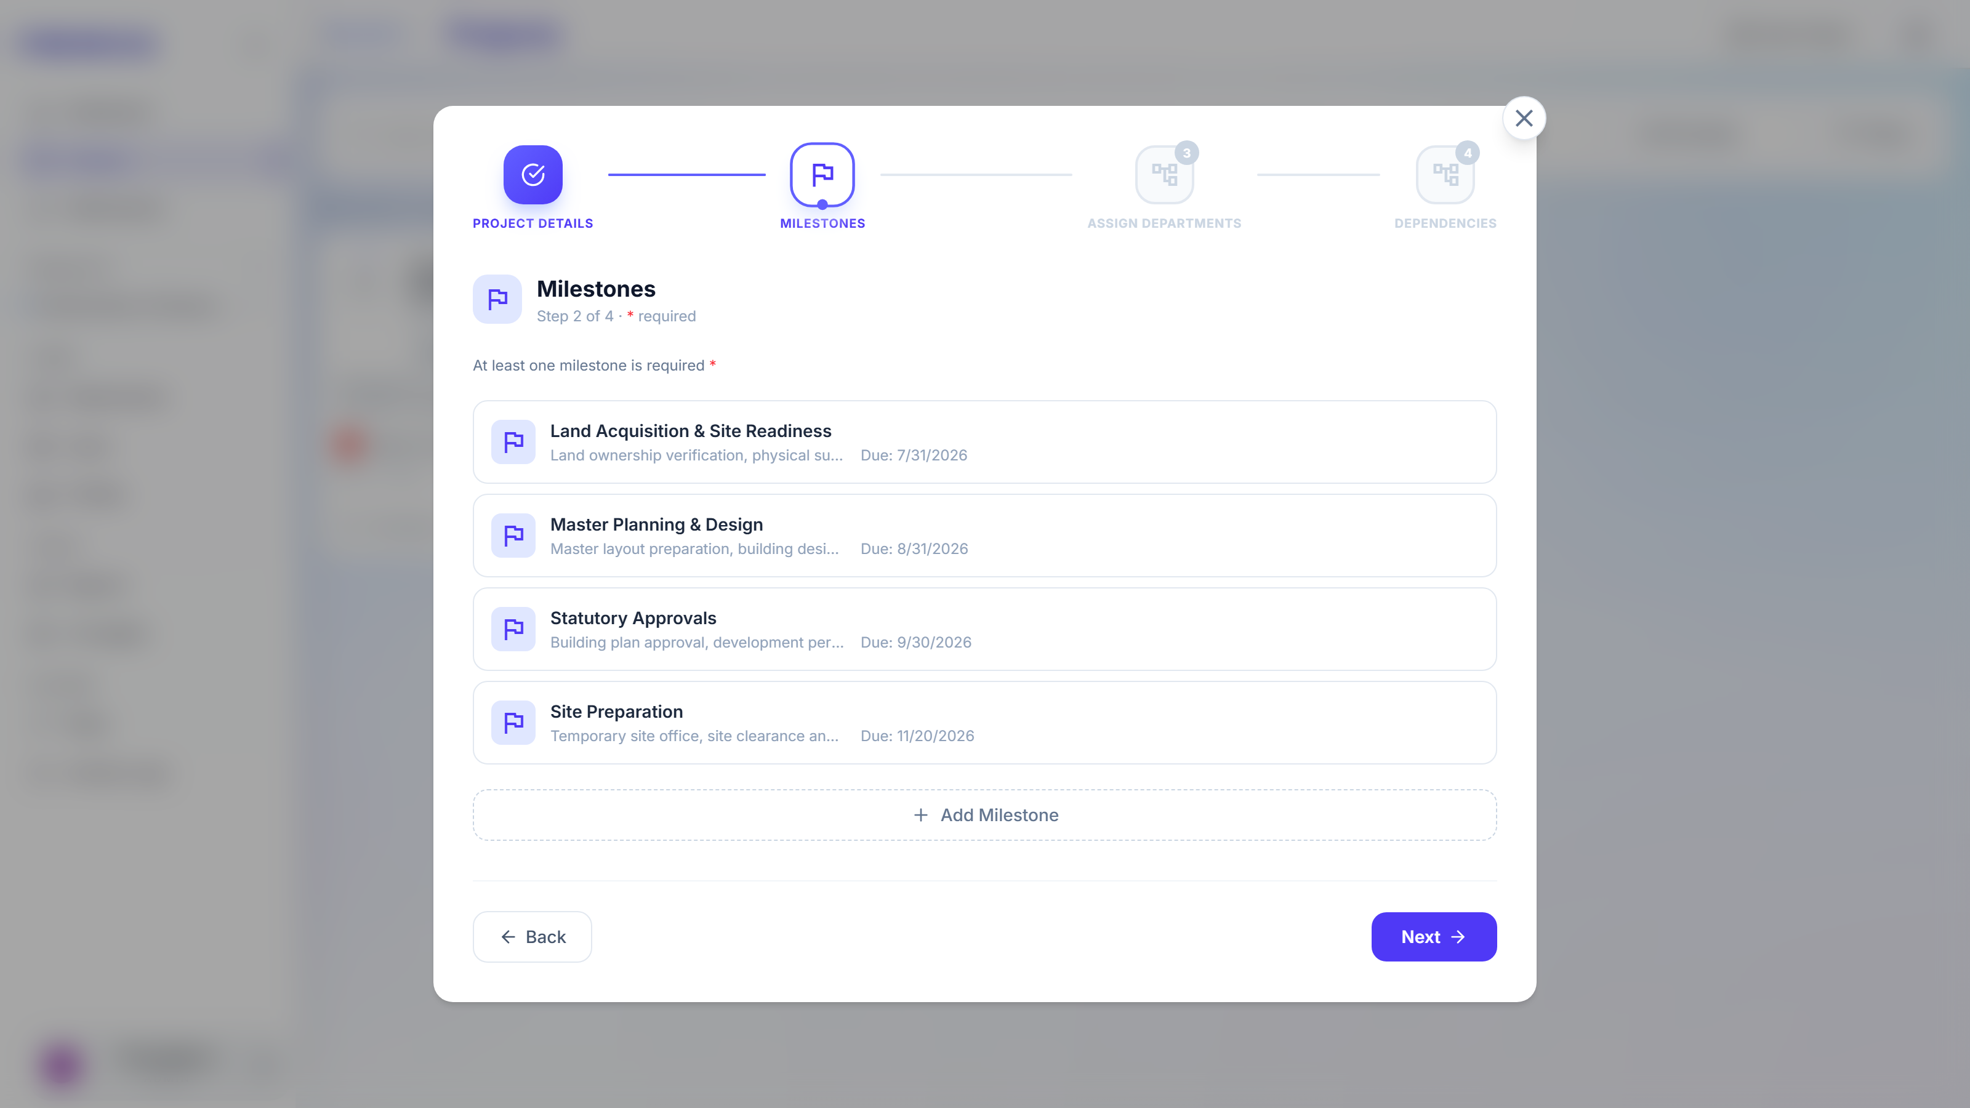
Admin
STEP 4
Milestones break the programme into trackable phases. Each needs a name, description and due date; at least one is required.

Slide 8
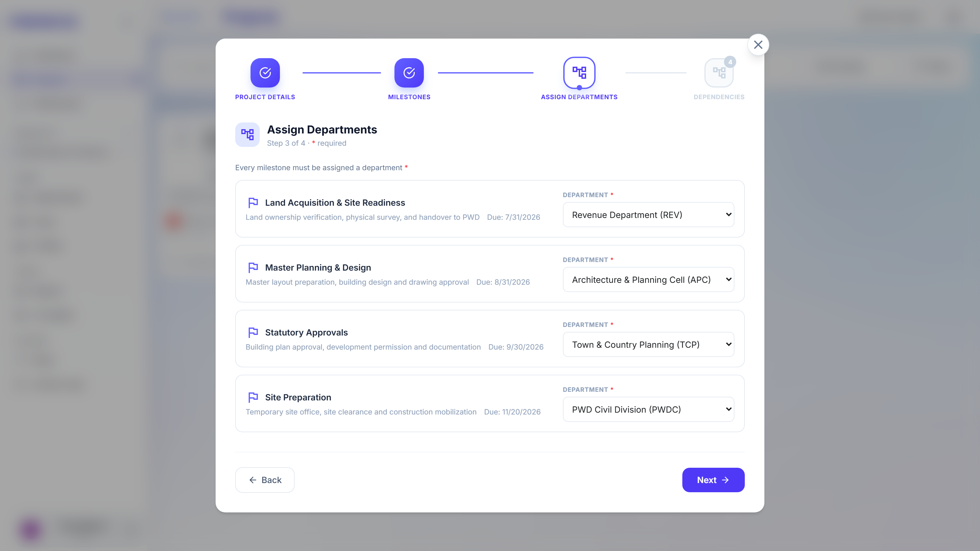
Admin
STEP 5
Every milestone is assigned an owning department, which is what later drives workload and capacity reporting.

Slide 9
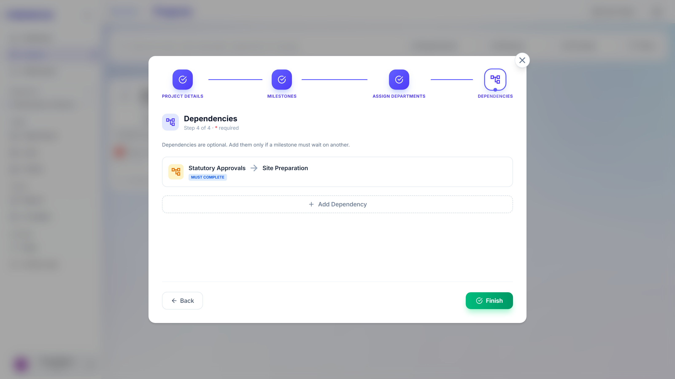
Admin
STEP 6
Dependencies declare which milestone waits on which, so blocked work is flagged before tasks start. Shown filled and ready — Finish is not pressed.

Slide 10
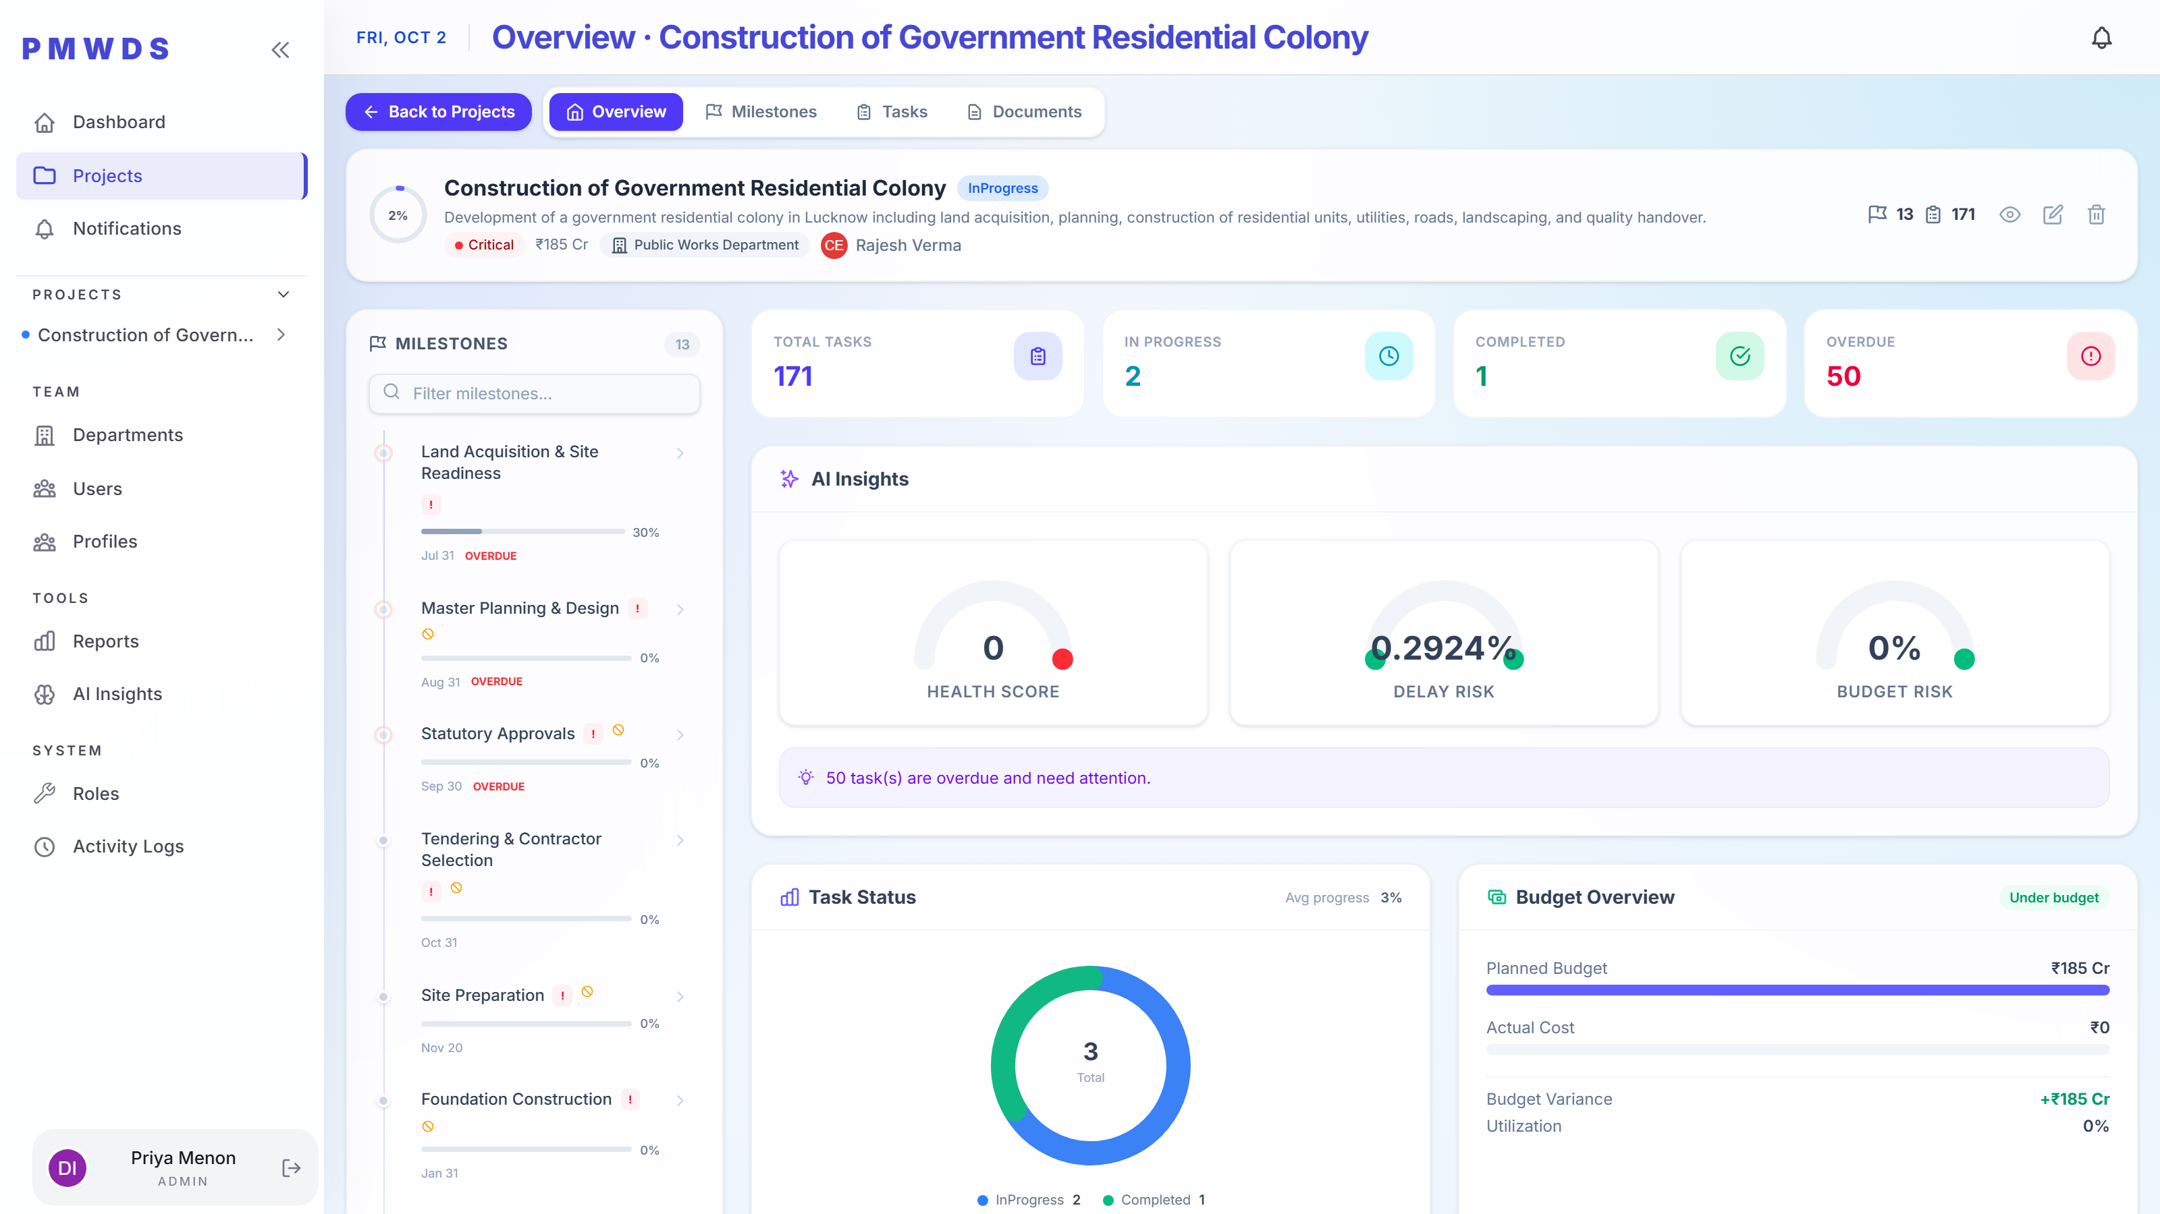
Admin
STEP 7
One project, every dimension of it: milestones, task status, budget, dependencies, team assignment and documents.

Slide 11
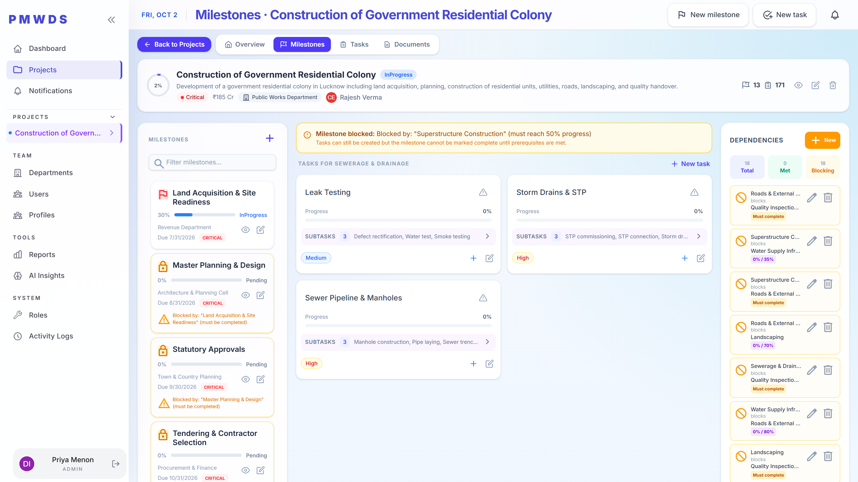
Admin
STEP 8
The full phase-by-phase timeline with status and dependency blocking, so the critical path is visible without exporting anything.

Slide 12
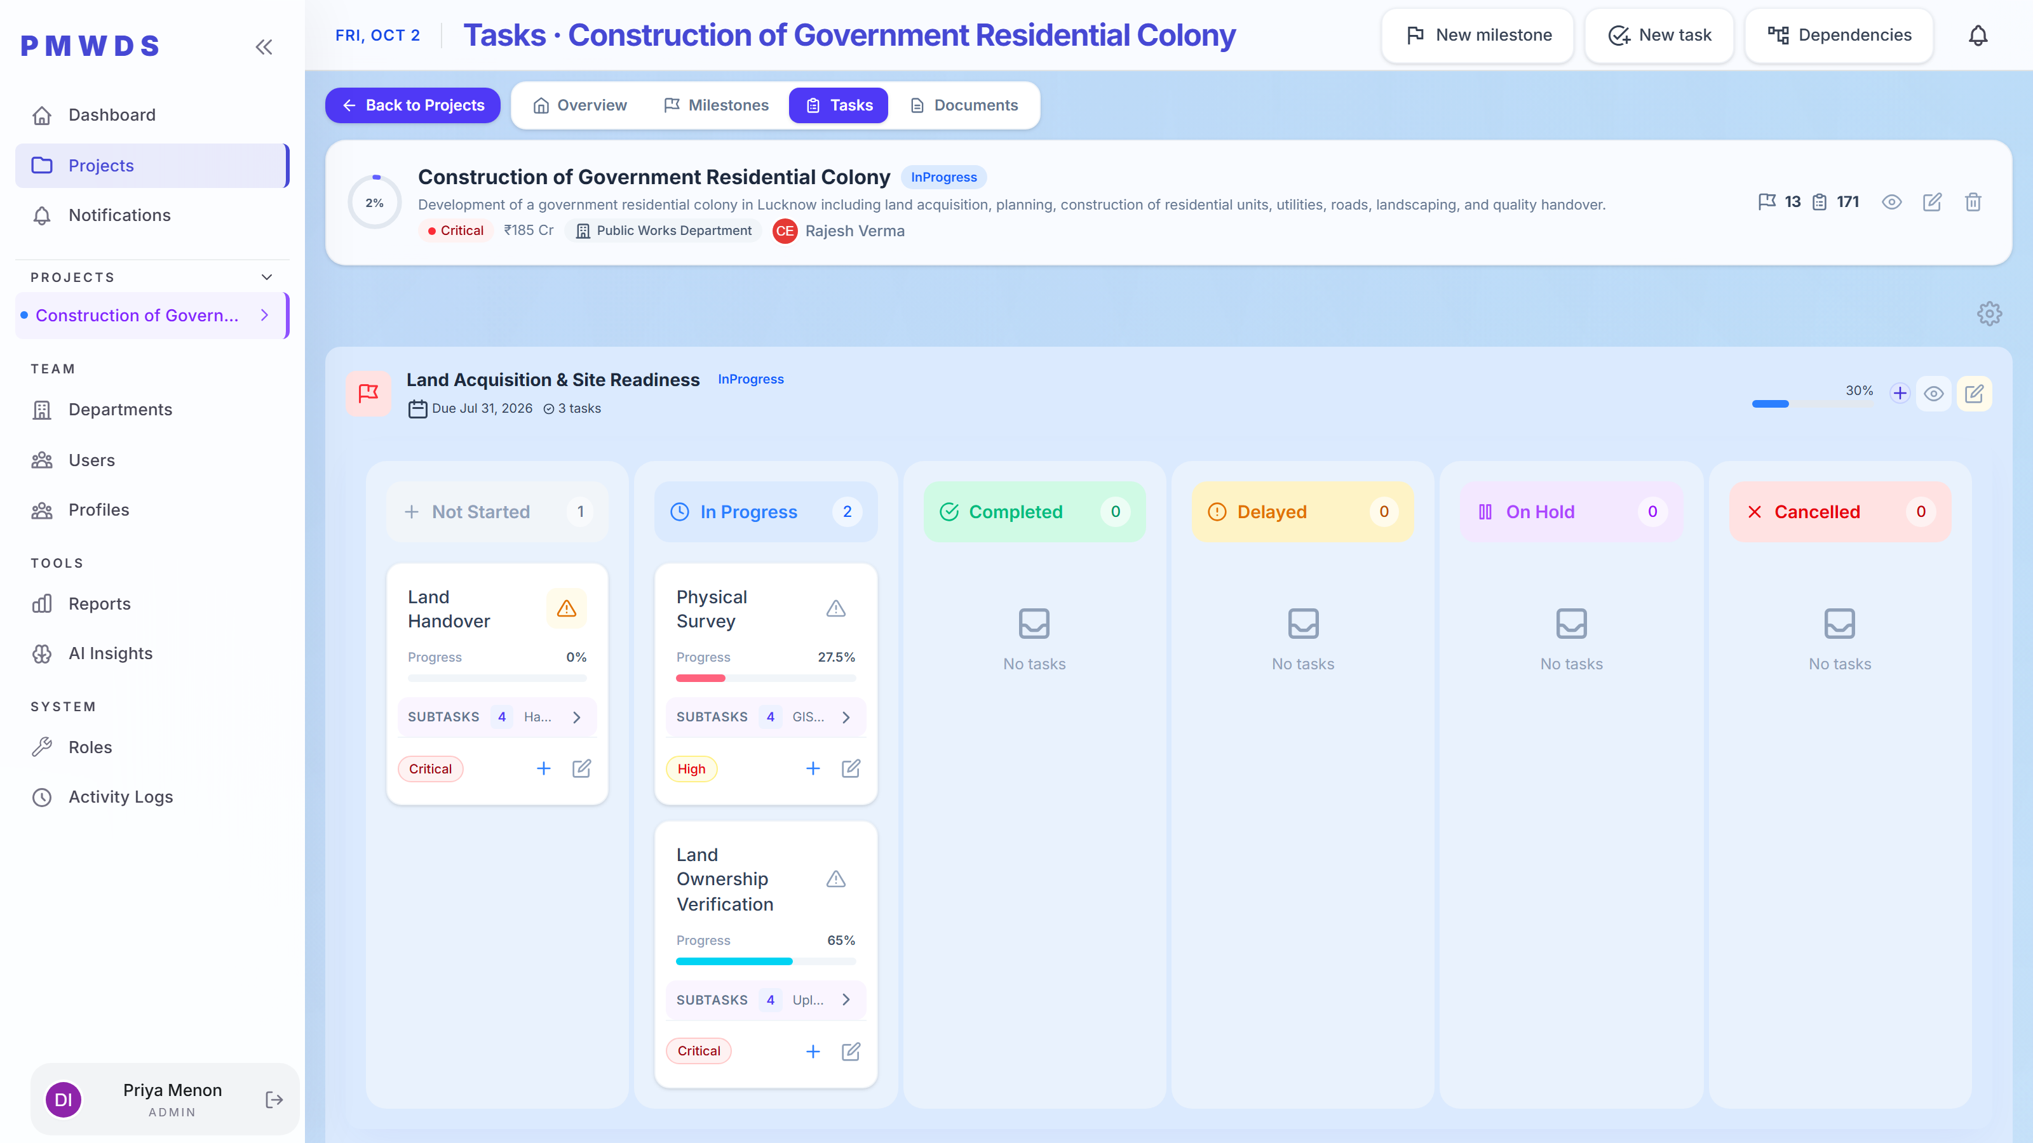
Admin
STEP 9
The widest task surface in the product — create, assign, escalate and decompose work down to subtasks.

Slide 13
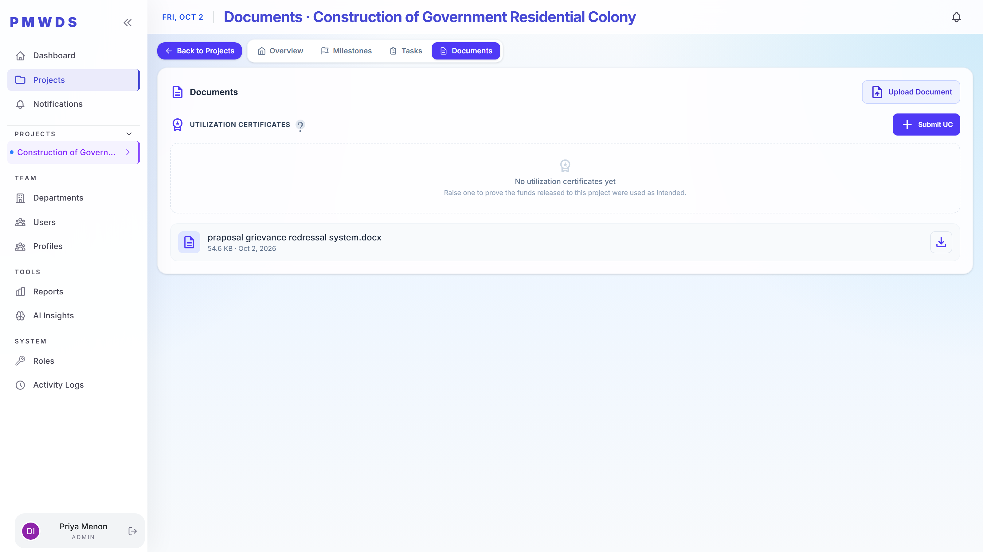
Admin
STEP 10
Documents and utilization certificates sit together: the register of project files, and the proof that released funds were used as intended.

Slide 14
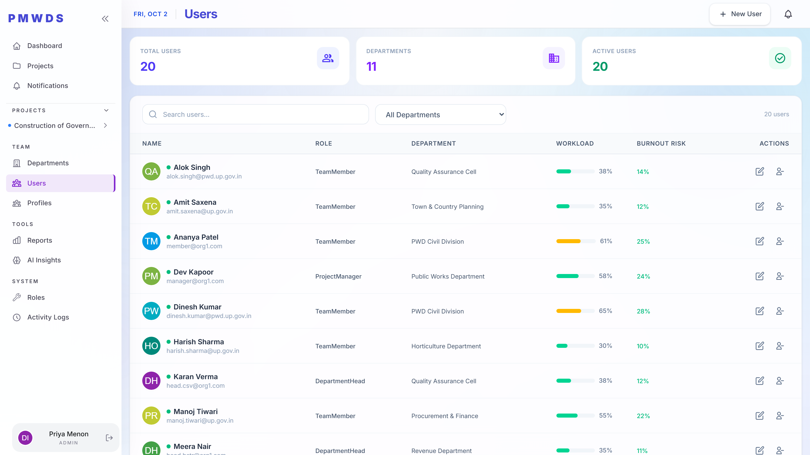
Admin
STEP 11
Every user in the organization with role, department, workload and burnout risk — and the ability to create, edit and deactivate them.

Slide 15
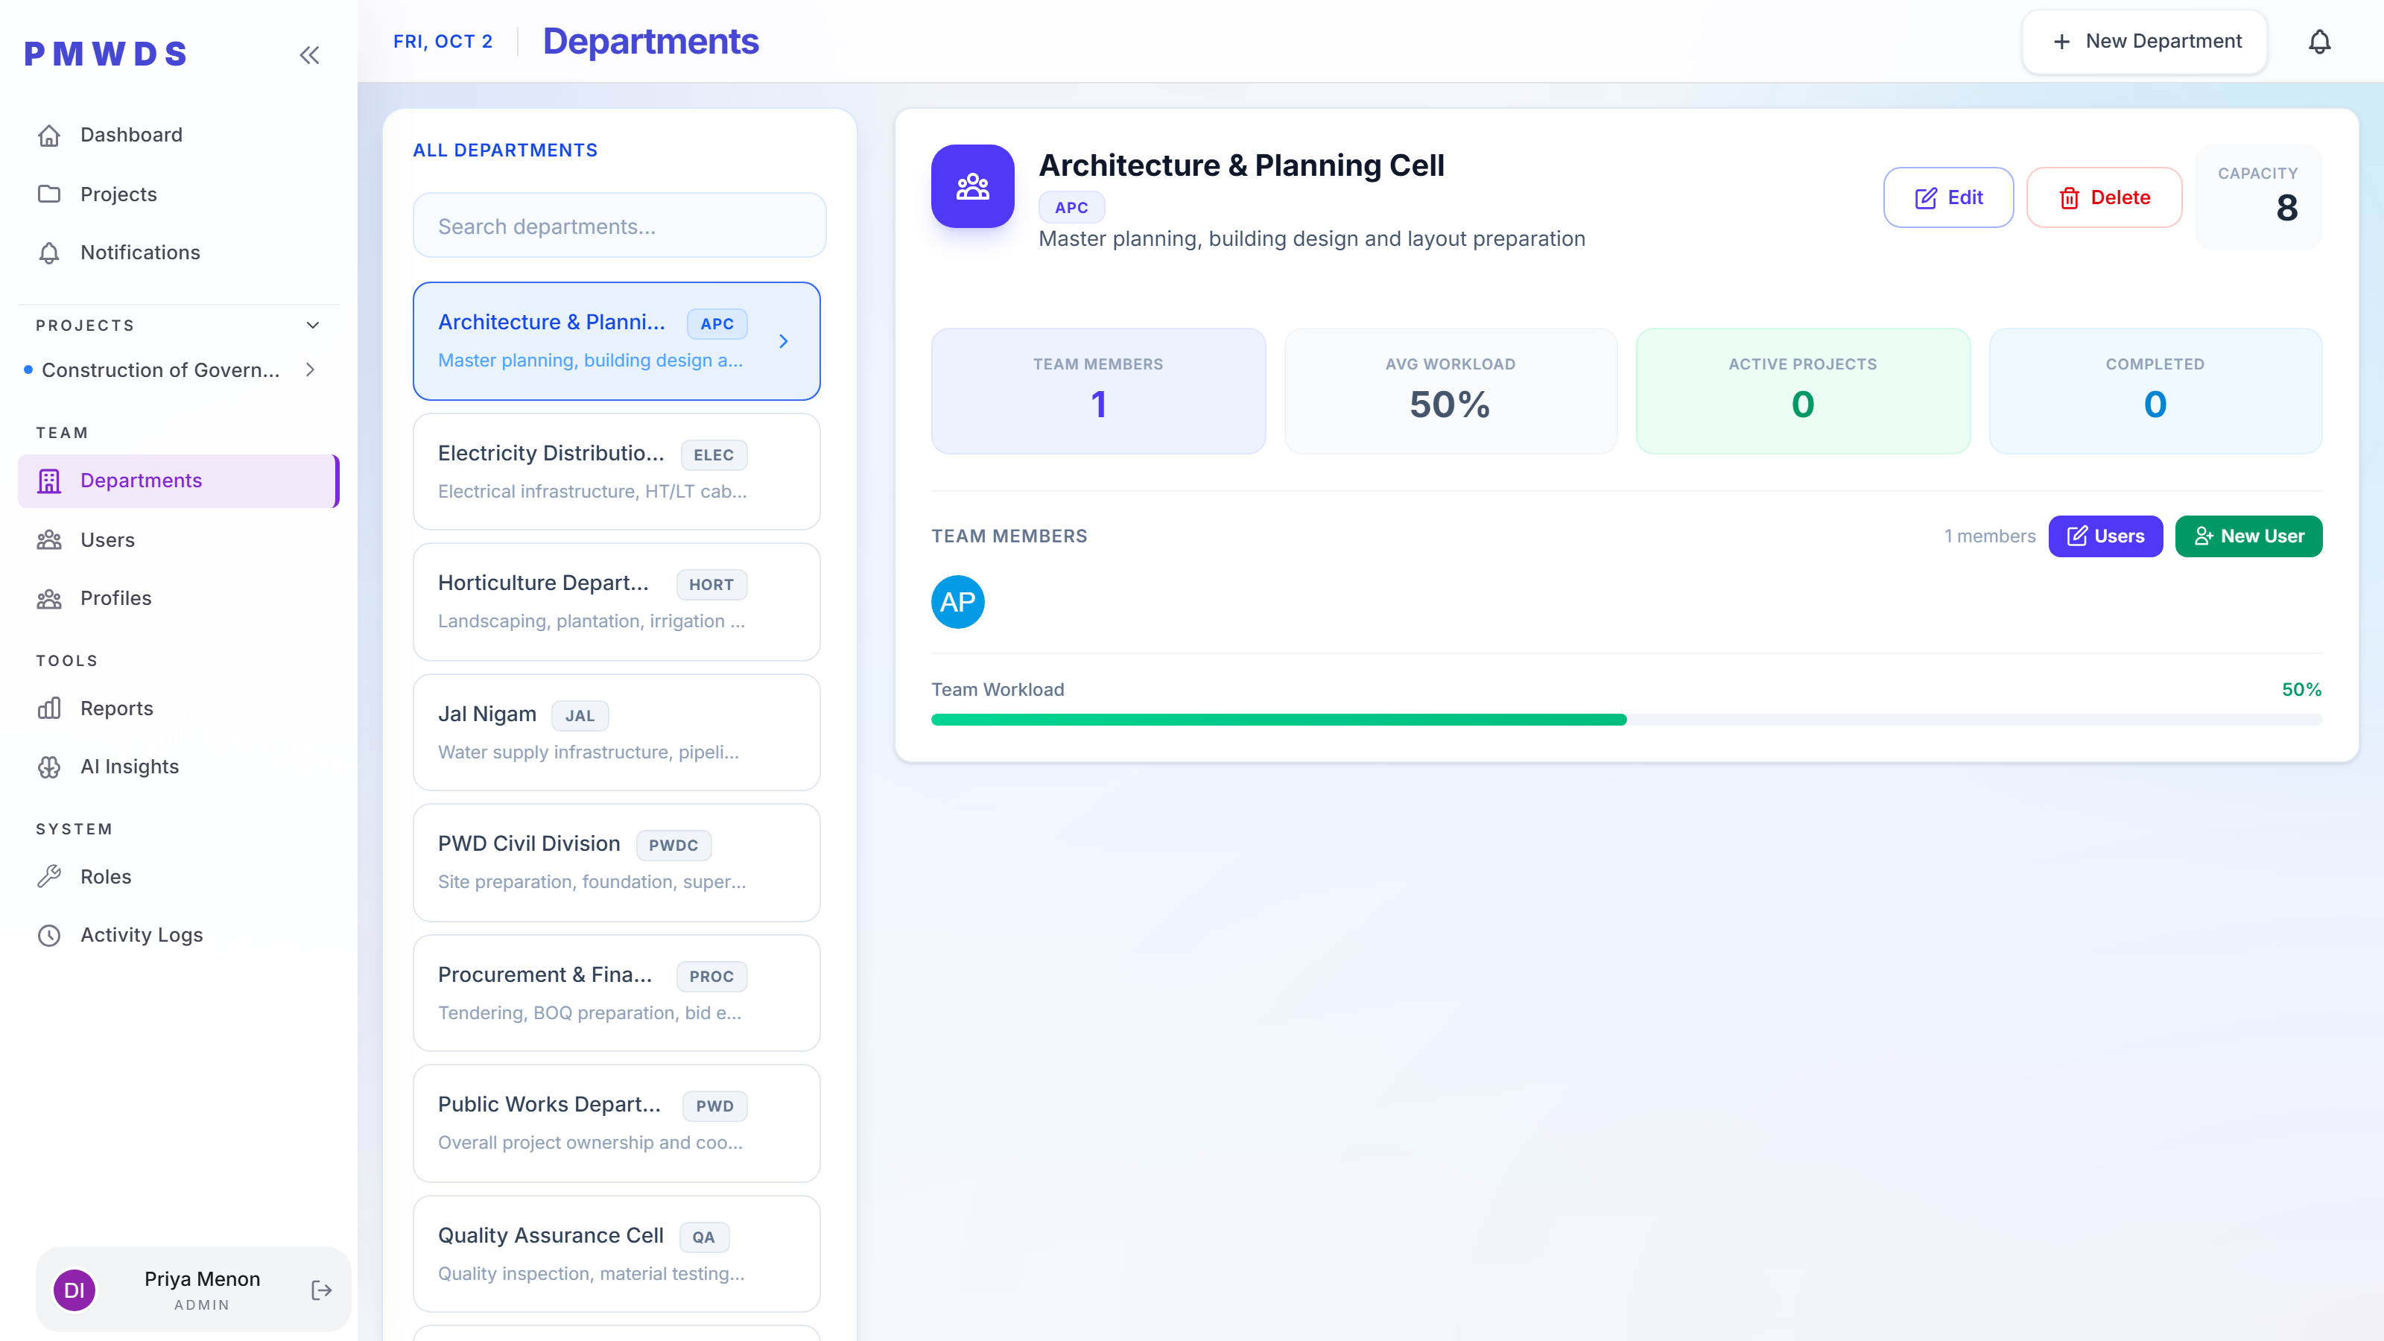
Admin
STEP 12
Departments are maintained here, and then become the scope that every lower role inherits.

Slide 16
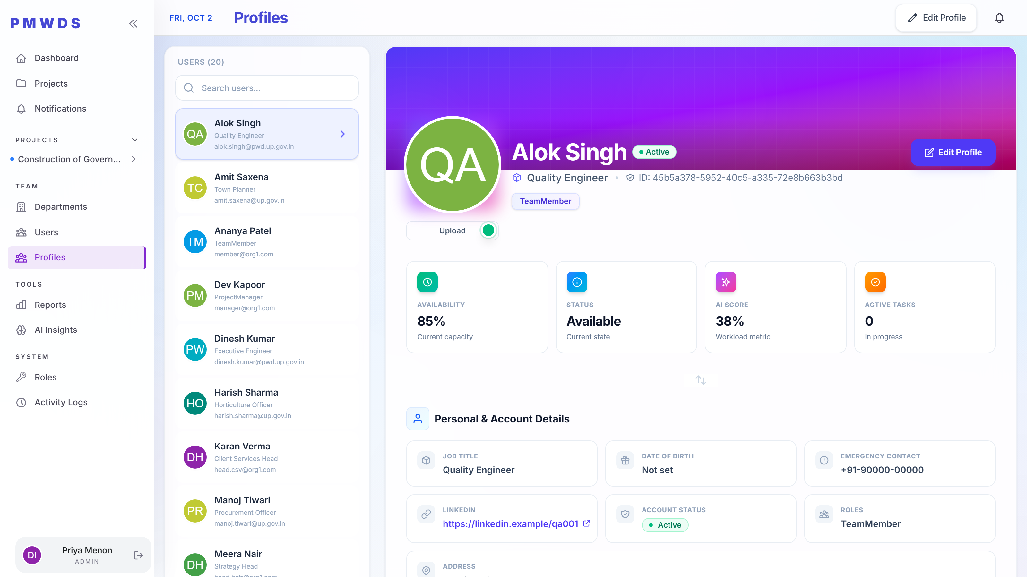
Admin
STEP 13
The detail layer behind staffing decisions: skills, proficiency and utilisation per person.

Slide 17
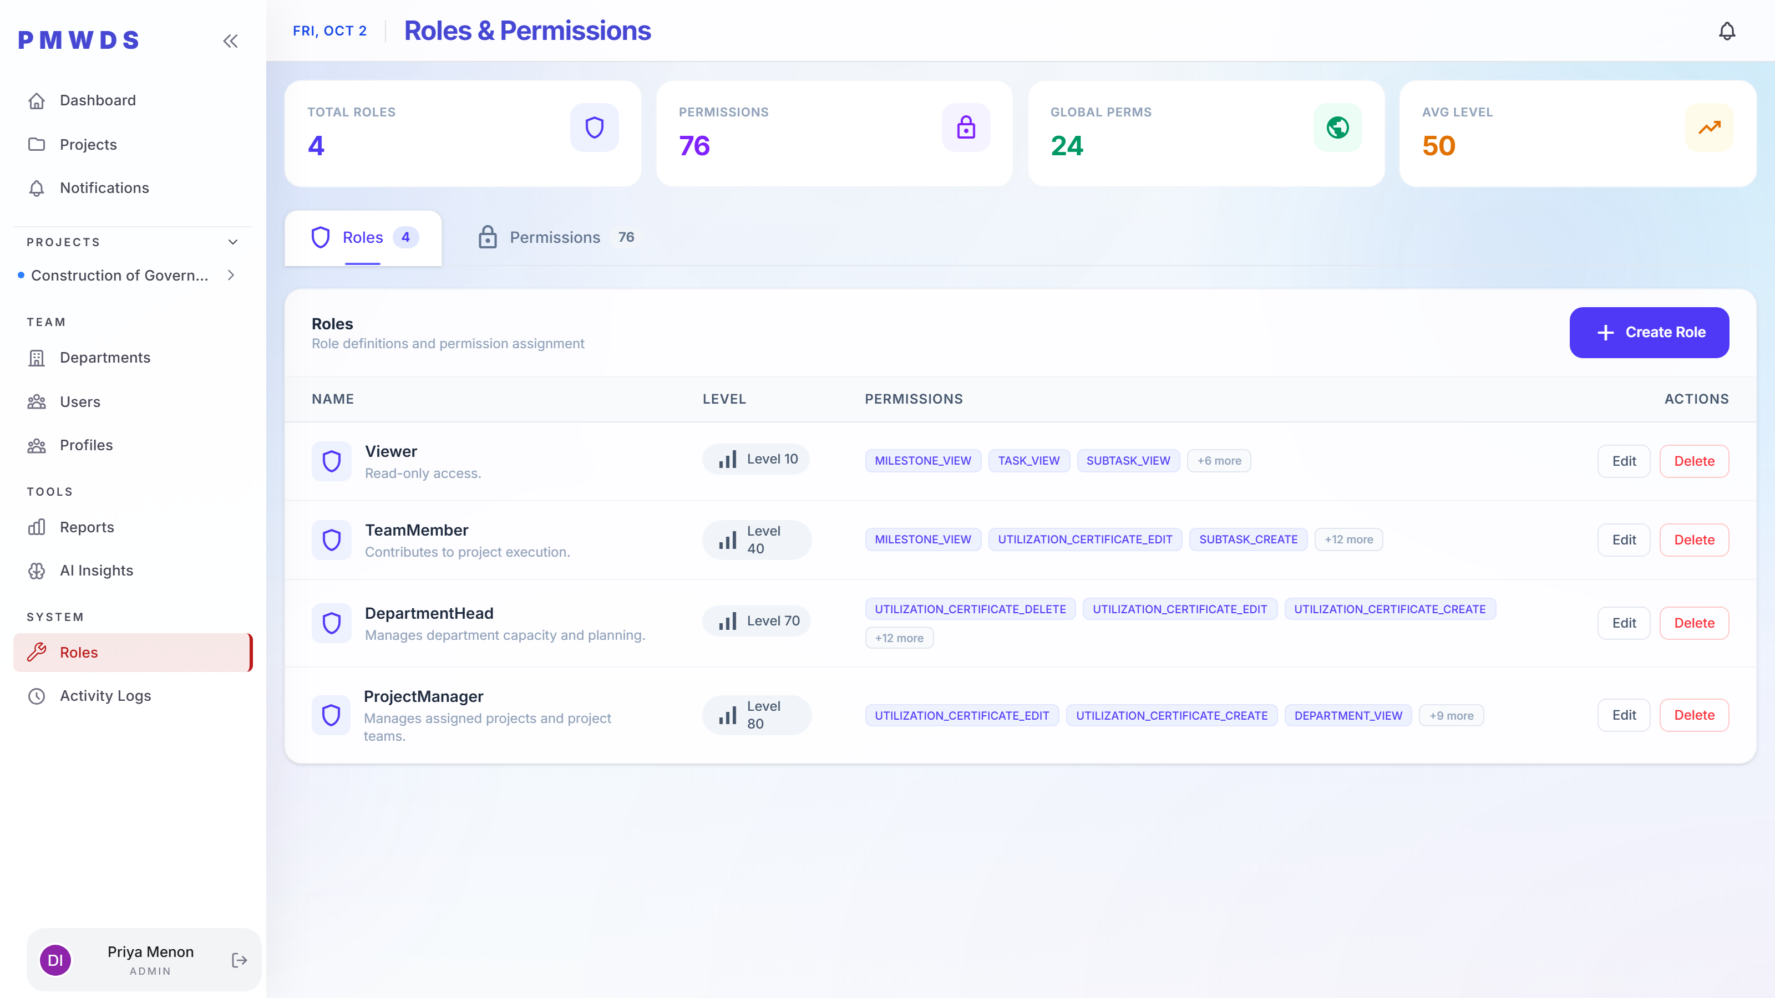
Admin
STEP 14
Roles and their grants are configuration. This screen is what makes every other restriction in this deck true.

Slide 18
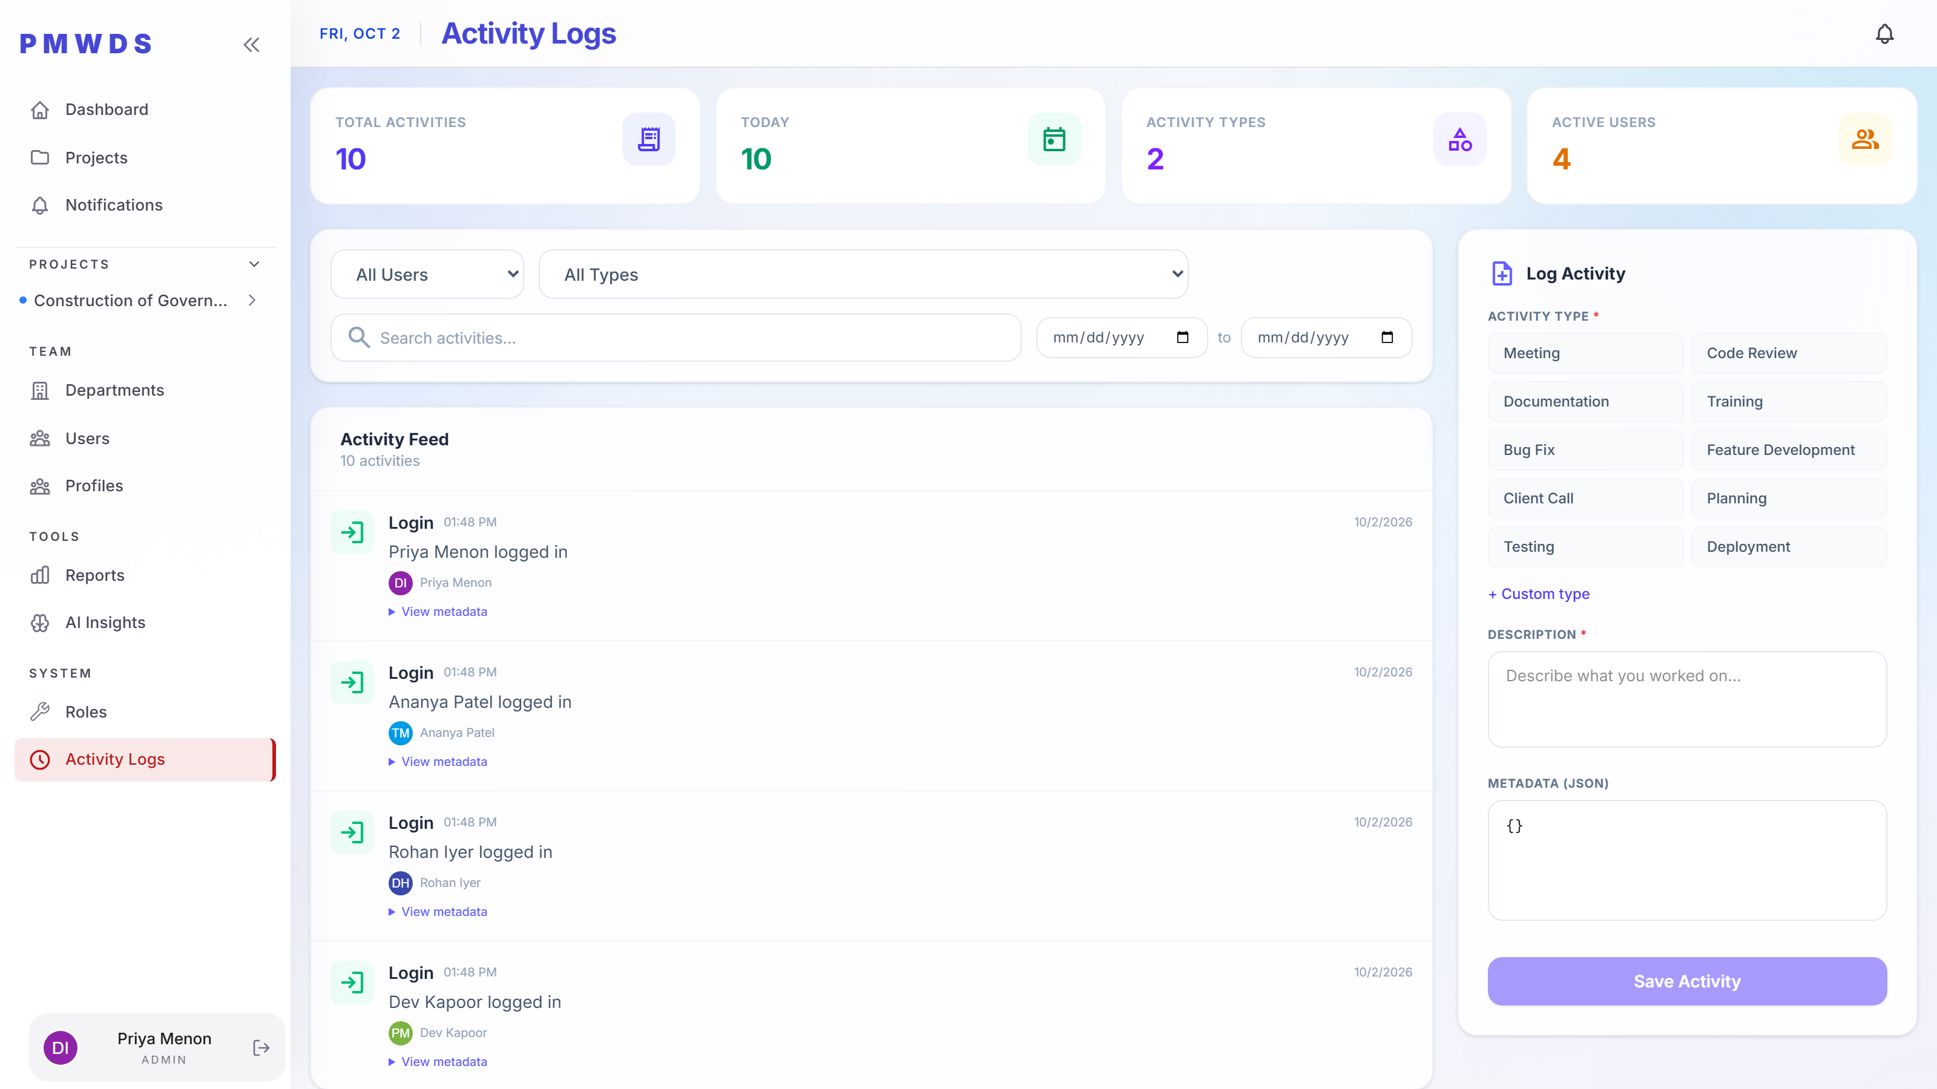
Admin
STEP 15
A system-wide activity trail across users, teams and projects — the evidence layer for any governance question.

Slide 19
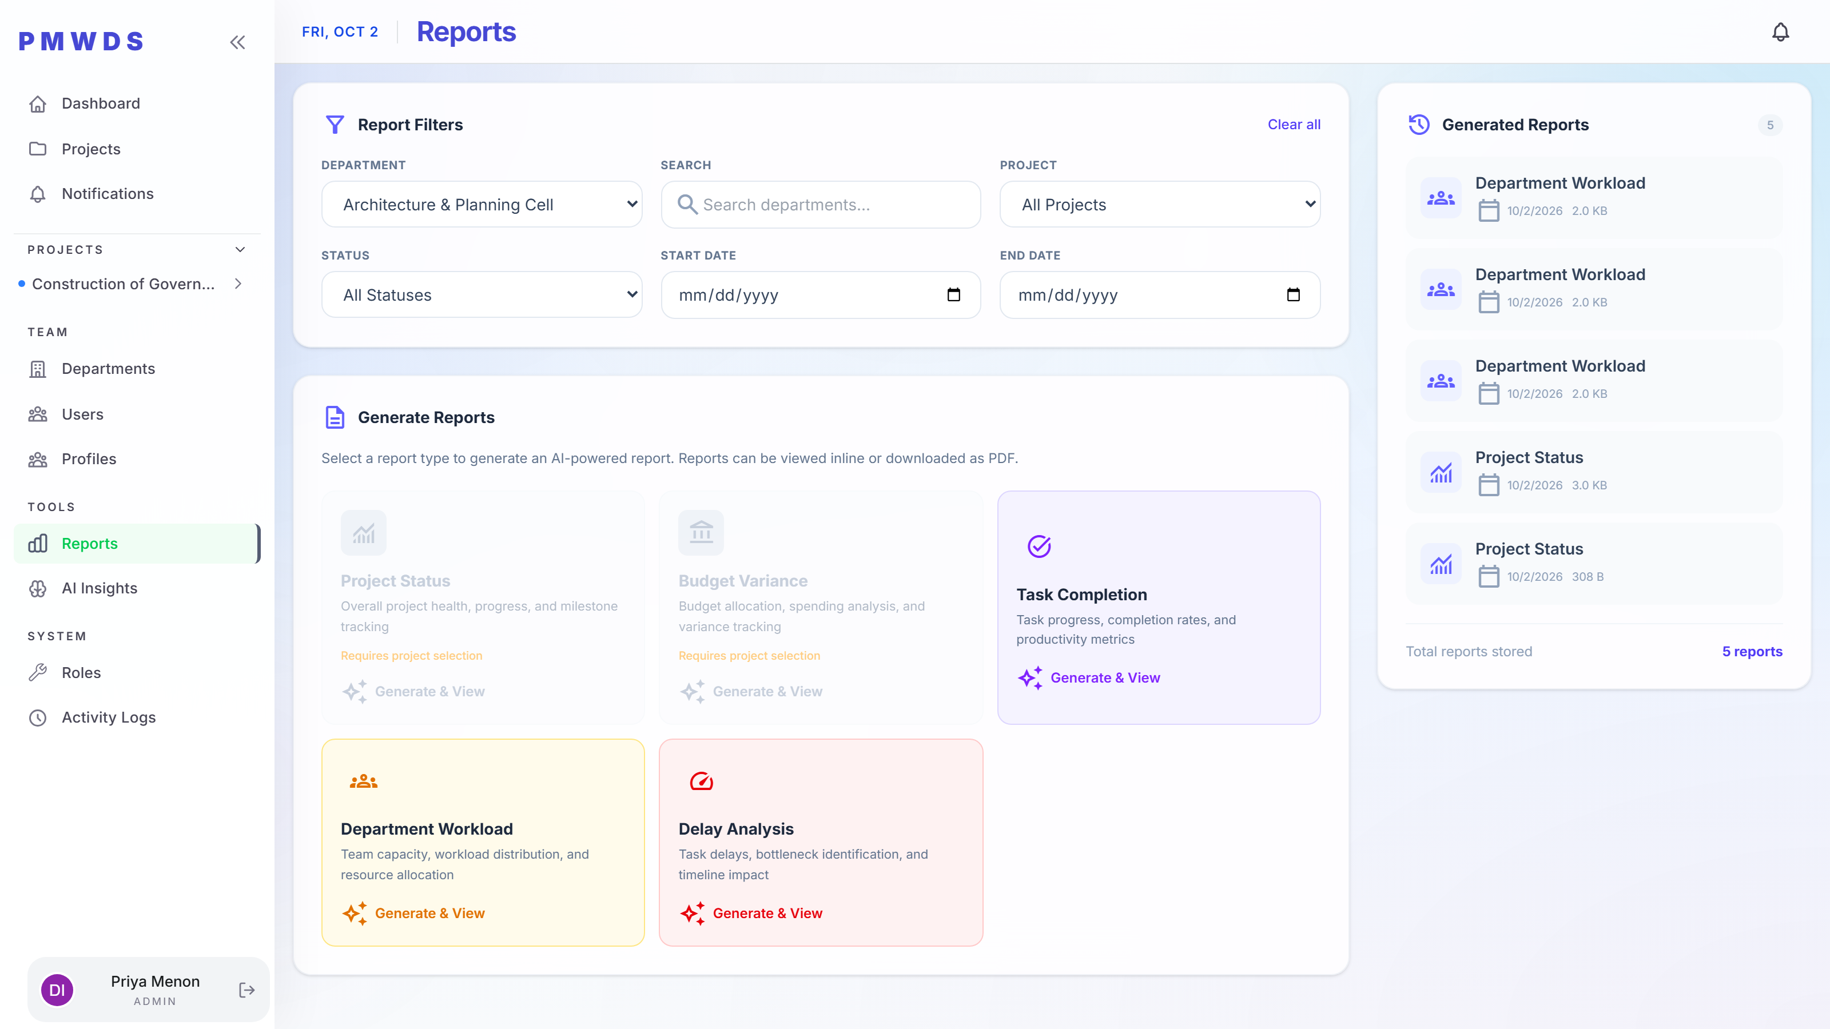
Admin
STEP 16
Pre-built report packs across delivery, finance and effort, each downloadable.

Slide 20
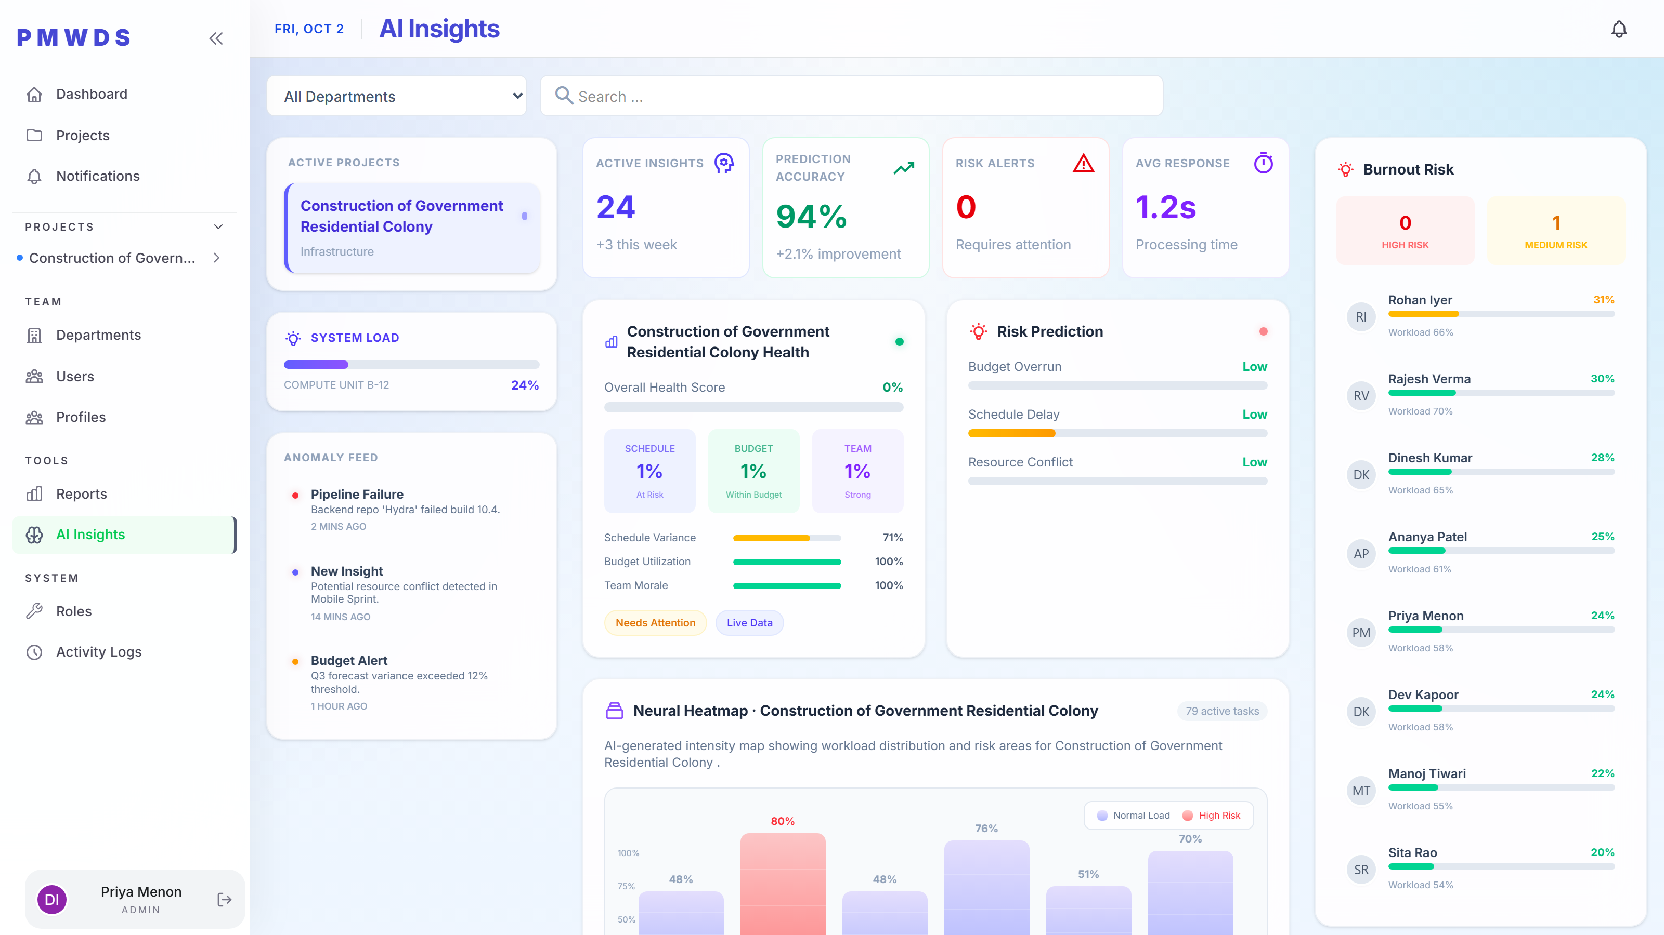
Admin
STEP 17
Risk prediction, timeline predictions and recommendations — the layer that turns project data into a decision.

Slide 21
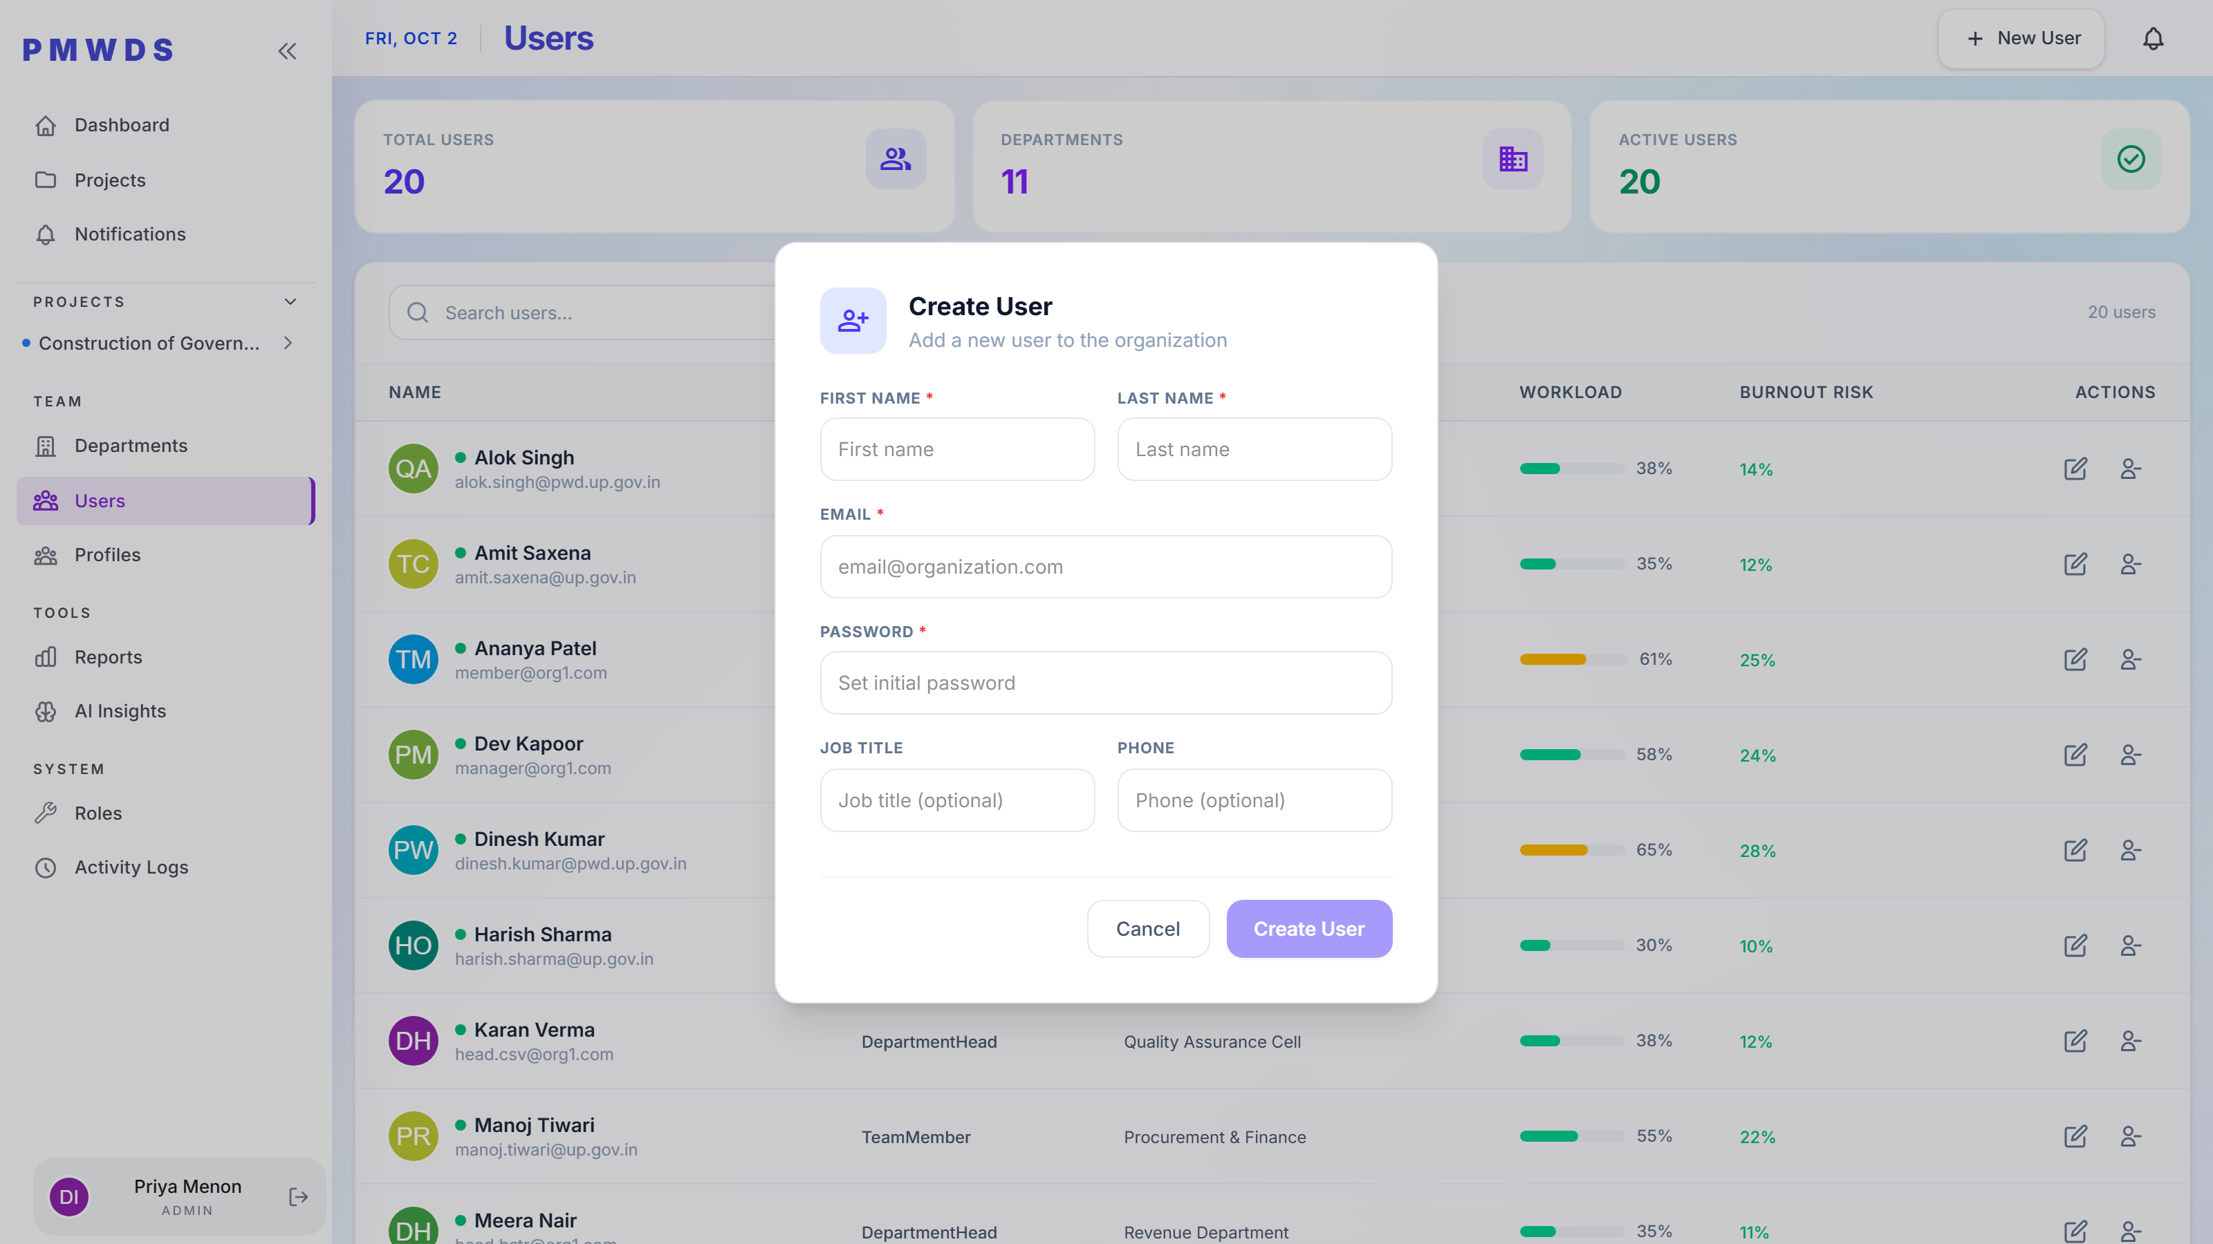
Admin
STEP 18
New starters are created directly with a role and department, without an administrator in the loop.

Slide 22
ROLE 2 OF 4
Manager
Owns assigned projects and the teams delivering them.
Relevant screens in this flow

Slide 23
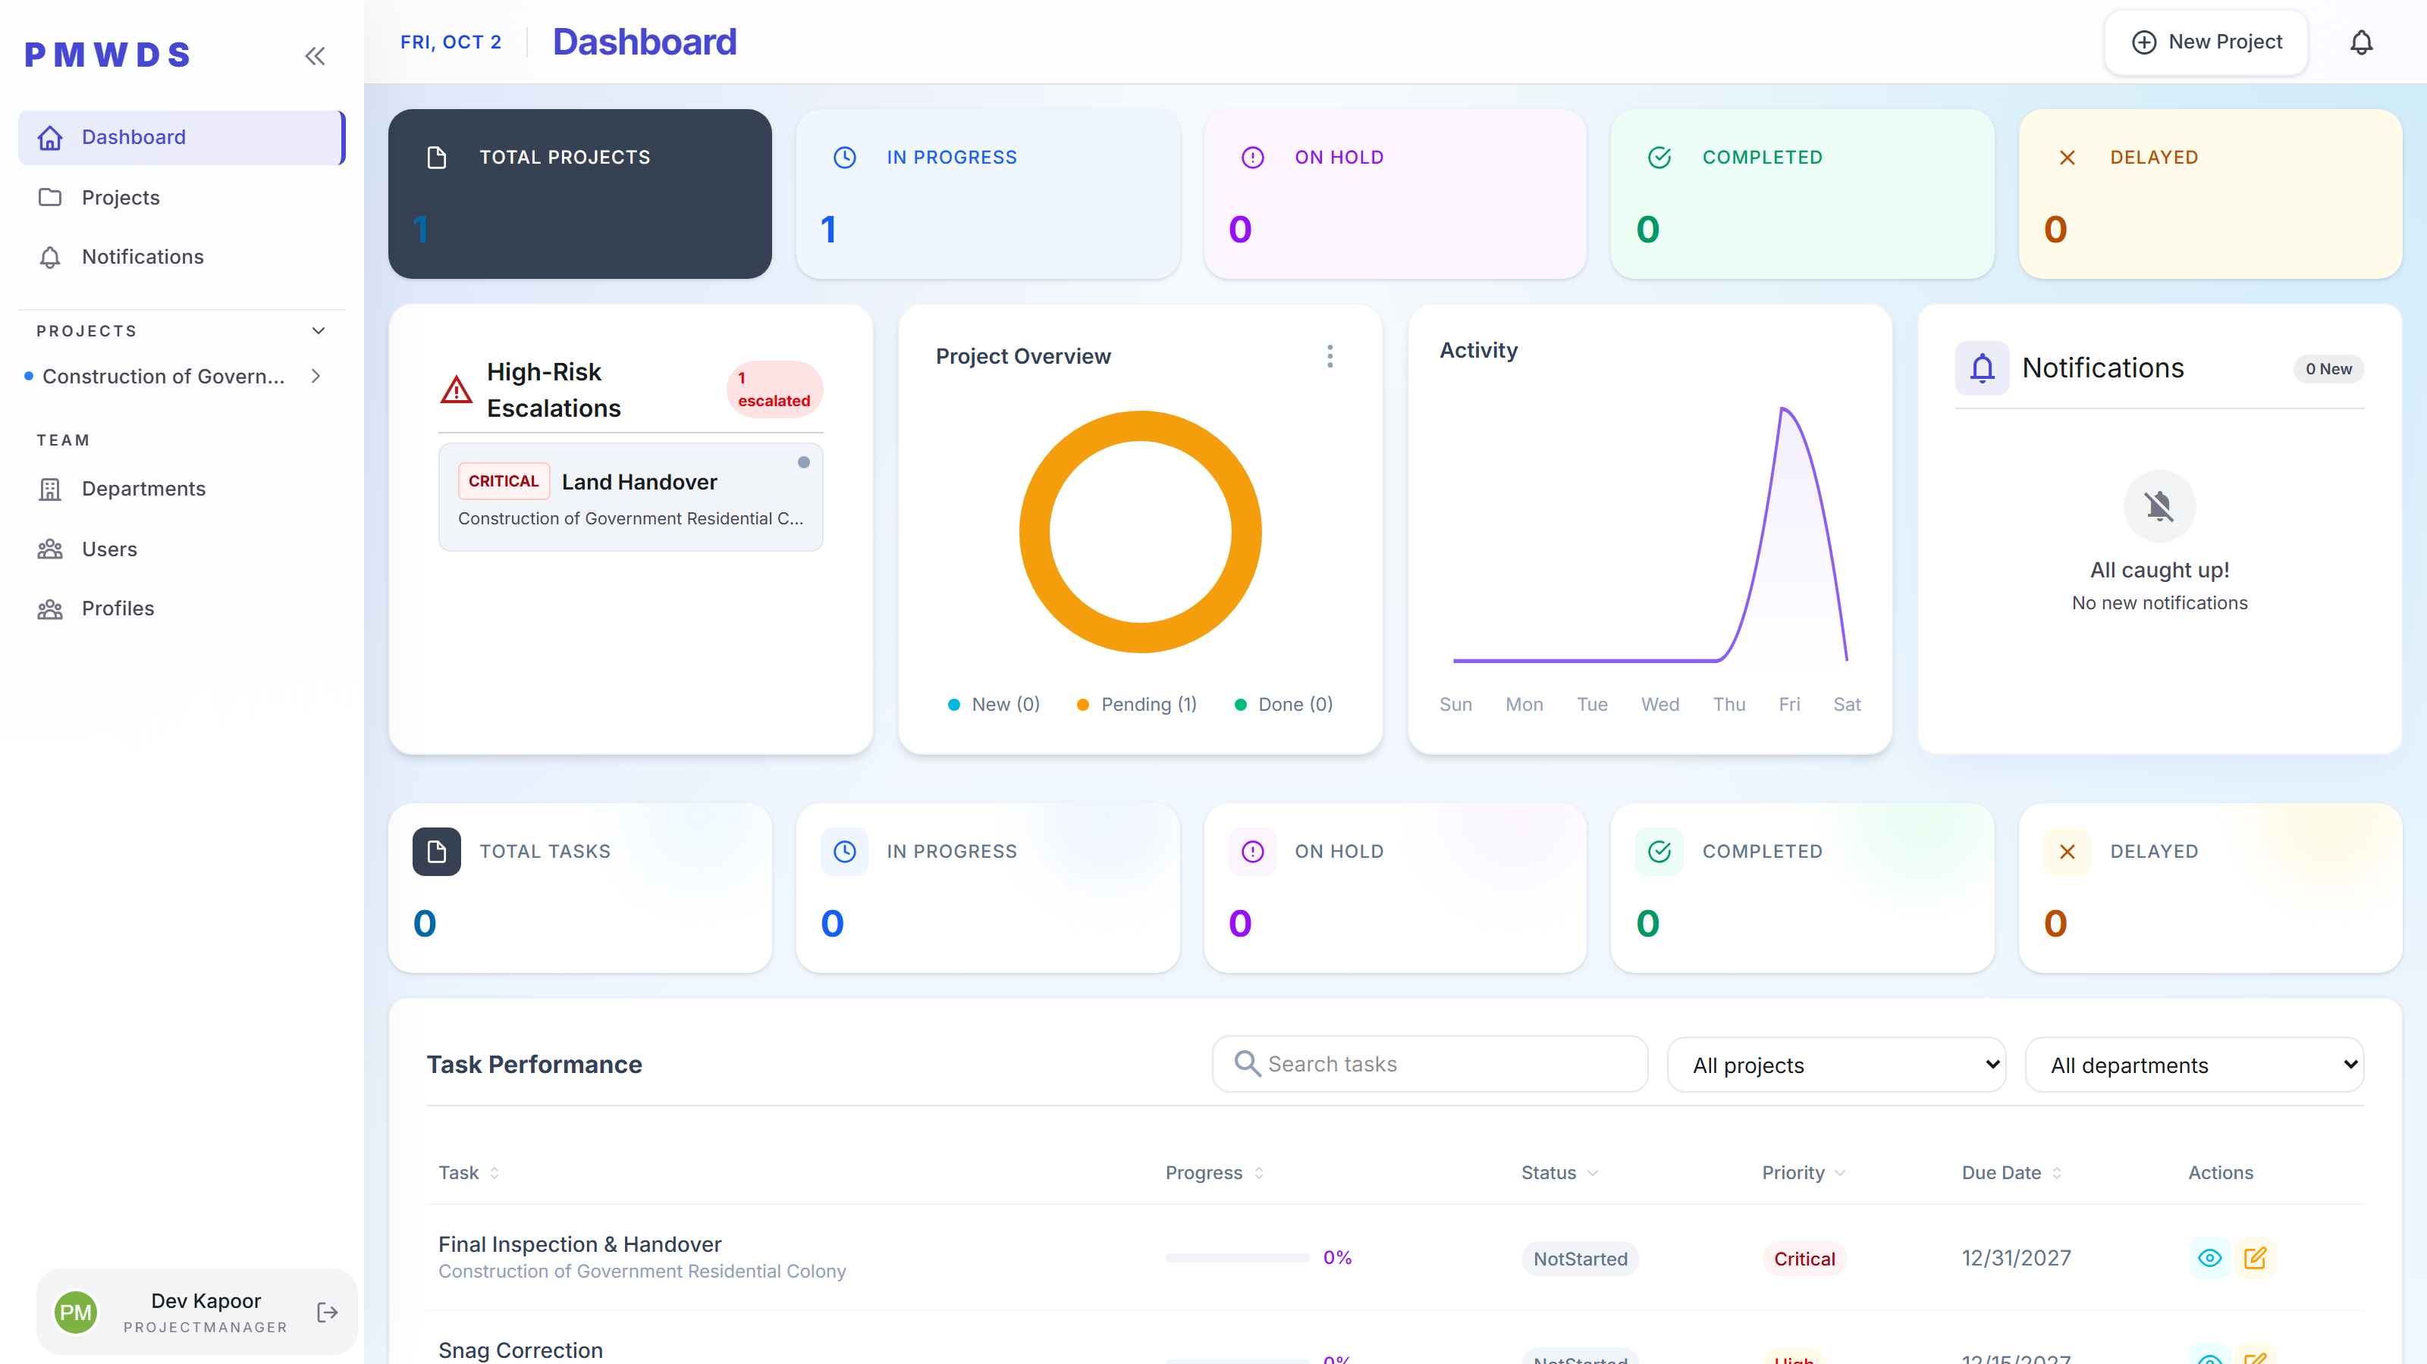
Manager
ROLE 3 OF 4
The same dashboard shows only relevant respected menu and pages for the manager.

Slide 24
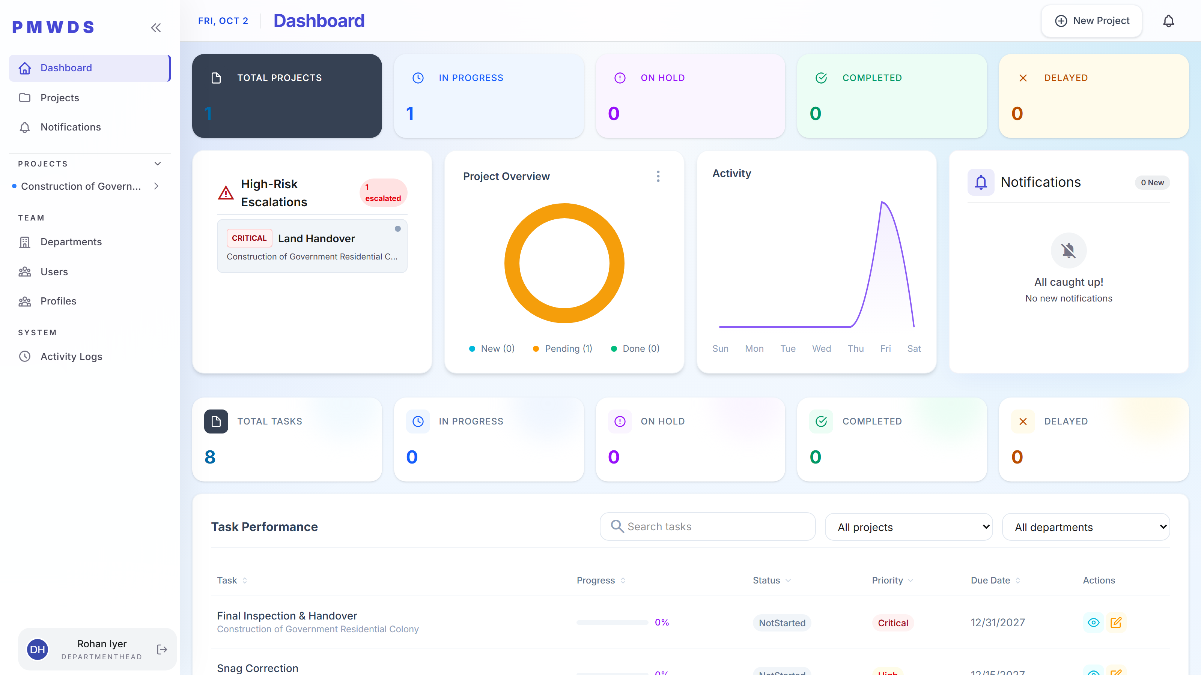
Department Head
ROLE 3 OF 4
The same dashboard shows only relevant respected menu and pages for the Department Head.

Slide 25
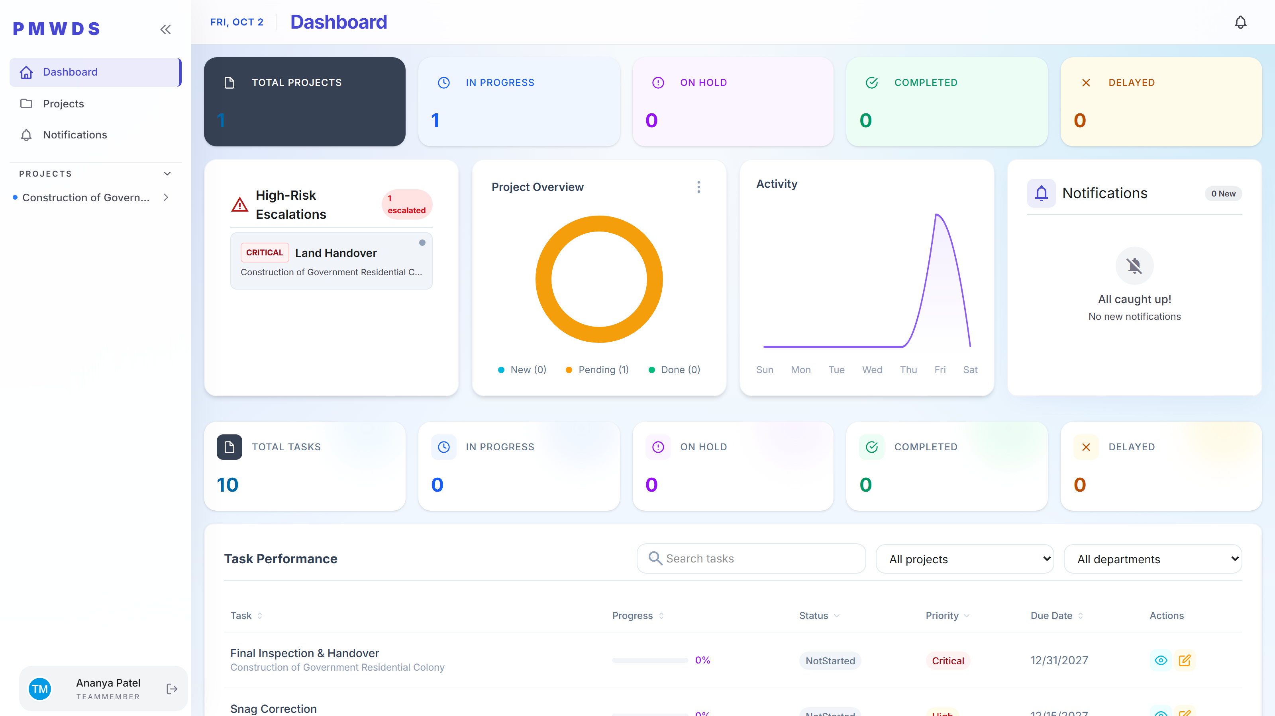
Team Member
ROLE 3 OF 4
Three menu items and no administration surface at all — no New Project action, and only the tasks actually assigned to this user.

Slide 26
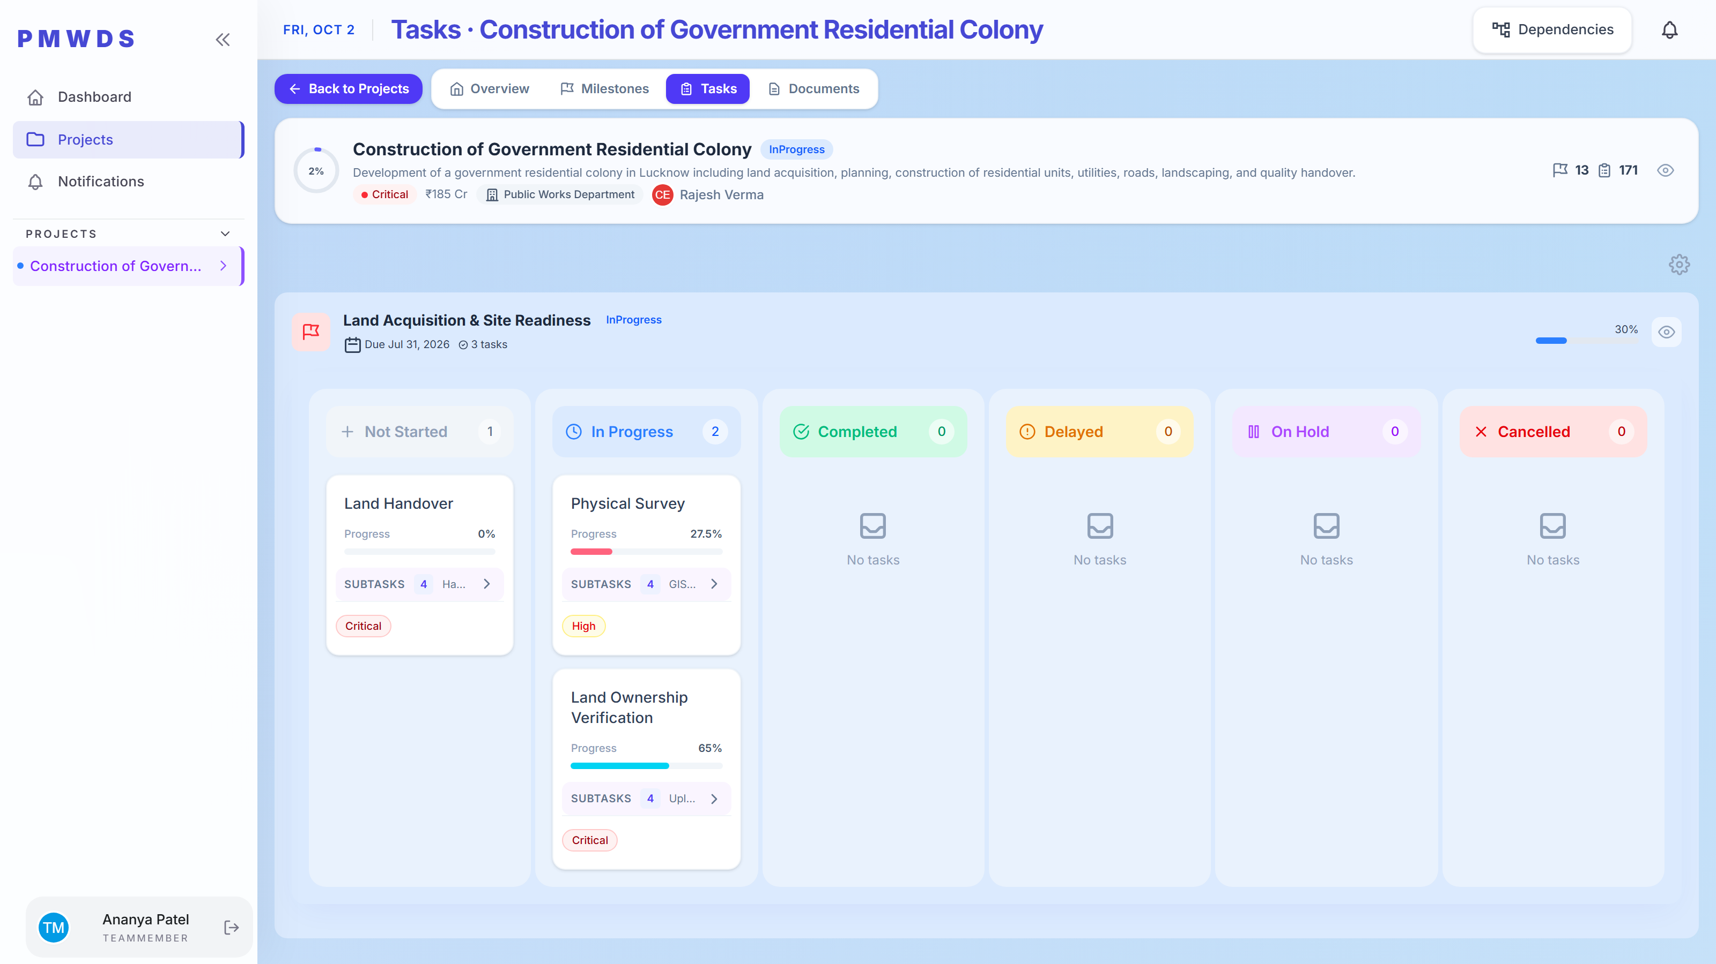
TeamMember
STEP 5
The real workspace: run the task, track time against it, record progress. No create, no escalate.

Slide 27
SIDE BY SIDE
The same dashboard, four different realities
One URL. Identical rendering. What changes is the navigation, the action set and the underlying data — resolved from role at request time.
Admin
Manager
DepartmentHead
TeamMember
Organization-wide
Assigned projects
One department
Execution only
Reports, AI insights and roles
Manages tasks and escalations
Own departmental milestones
Only assigned tasks
Manages people and roles
User list is read-only
Manages departmental users
Time tracker and progress
16/18 modules
12/18 modules
13/18 modules
9/18 modules

